Slide 1
CSCE 330 Programming Language Structures Introduction and History
Fall 2021
Marco Valtorta and James O’Reilly
mgv@cse.sc.edu and oreillyj@cse.sc.edu

Slide 2
A Typical Textbook: Scott [S]
Foundations
Introduction: history, translation
Syntax, names, scopes and bindings, static semantics
Semantics (not fully covered in [S])
Core Issues in Language Design:
Control flow
Data types
Subroutines and control abstractions
Data abstraction and object orientation
Programming models (paradigms):
Imperative languages
Object-oriented languages
Functional languages
Logic languages
Concurrency
Notes:
Binding – associating names with memory locations (variables/functions) and types (classes, data types)
Syntax -- These are the rules of correctly formed sentences – e.g. “Colorless green ideas sleep furiously” (Chomsky, I believe)
Semantics – The problem with the above quote is that it is meaningless… in programming 2+”chicken” is likely an error (though It might allow implicit conversions and result in “2chicken”
Static semantics examples: compile time checking such as type checking . Dynamic is at run time (e.g. JavaScript)
Imperative: use a series of instructions to modify state. Object-Oriented: Encapsulation& Data-hiding, Inheritance, Polymorphism (ability to write functions to work on multiple types, can potentially utilize inheritance and generic programming) Abstraction -- ability to work conceptually
Functional: (https://wiki.haskell.org/Functional_programming) A more mathematical way of looking at programming – “function” as mathematical function, not as imperative “procedure”. “Pure” Functions have inputs and a result with no side-effects (normally). Immutable data (makes copies without changing the input). Also, the call to a function should always yield the same result with the same inputs ~ Referential transparency (“Purity” trait also). In reality , most languages aren’t purely functional.
Concurrency: (related but not the same as parallel programming) The ability to run separate, perhaps only tangentially related processes (or threads within a program) and deals with sharing data/resources, locking of data, etc.
Logic Languages (like Prolog) – declarative – deal with formal logic. Prolog “programs” are knowledge bases.
Best definition of a declarative language:
(informally) Lower-level language (imperative languages) programmers have to concern themselves with "what" and "how" the output of a programming language works. In a declarative languages you are much more concerned with "what the output should look like" and the language/environment will figure out the "how" for you (though you are never 100% divorced from the how for non-trivial problems). Prolog environment utilize knowledge bases to prove statements true or false.
Bratko, Ivan. Prolog programming for artificial intelligence. Pearson education, 2001.

Slide 3
Disclaimer
The slides are based on many sources, including several other fine textbooks for the Programming Language (PL) Concepts course
The PL Concepts course covers topics PL1 through PL11 in Computing Curricula 2001
One or more PL Concepts course is almost universally a part of a Computer Science curriculum
In some curricula, the contents of our course are divided into two semesters, the first of which is devoted to functional and logic programming
Notes:
…cry all the way to the bank

Slide 4
Why Study PL Concepts?
Increased capacity to express ideas
Improved background for choosing appropriate languages
Increased ability to learn new languages
Better understanding of the significance of implementation
Increased ability to design new languages
Background for compiler writing
Overall advancement of computing
Notes:
…programming constructs in one language can be expressed in other languages…
…understanding a variety of languages gives you insight into which one(s) will work better…
“multi-lingual” programmers may be more likely to adapt to a new environment
They are also more likely to identify a situation in which their main languages may be ill-suited and know of one that will work better
…C++ after Java (relatively) easy
We’re really trying to focus on different languages
I’ve joked that it might be easier to teach non-programmers Prolog… you guys just can’t let go of the wheel and let backchaining do its job
Haskell (and Prolog) use recursion for iteration – sometimes it’s just easier (if not faster) to see how algorithms work – Mergesort example
Significance of impl.: Bytecode vs. compilation vs. pure interpretation
<last few are advanced>
5. Many languages extensions of pre-existing (C -> C++, obviously)
6. Understanding language theory as related to translation/compilation important for making language usable
7. Languages are our tools, also ties in to the formal language theory so advances there may be fundamental (lot of this is done… completely?)

Slide 5
Increased capacity to express ideas
Sapir-Whorf hypothesis: “language is not simply a way of voicing ideas, but is the very thing that shapes those ideas. One cannot think outside the confines of their language.”
Figure out how to do things in languages that don't support them:
lack of suitable control structures in Fortran
use comments and programmer discipline for control structures
lack of recursion in Fortran, CSP, etc
write a recursive algorithm then use mechanical recursion elimination (even for things that aren't quite tail recursive)
lack of named constants and enumerations in Fortran
use variables that are initialized once, then never changed
lack of modules in C and Pascal
use comments and programmer discipline
lack of iterators in just about everything
fake them with (member?) functions
Notes:
[S]; Whorf hypothesis statement from http://www.mnsu.edu/emuseum/cultural/language/whorf.html, retrieved 2010-08-17
Modules, in the C sense, means respecting interfaces.
Ask if they know what an iterator is (show Java example) ?

Slide 6
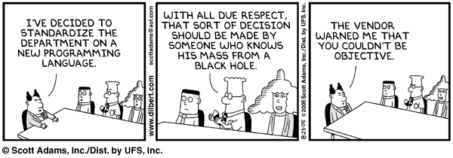
Improved background for choosing appropriate languages
Source: http://www.dilbert.com/comics/dilbert/archive/dilbert-20050823.html
Notes:
Again, ignoring ignorance, you may find that certain problems may be easier in certain languages. You may (partially) reinvent the wheel if you don’t switch languages when appropriate.

Slide 7
Increased ability to learn new languages
Easy to walk down language family tree
Concepts are similar across languages
If you think in terms of iteration, recursion, abstraction (for example), you will find it easier to assimilate the syntax and semantic details of a new language than if you try to pick it up in a vacuum
Analogy to human languages: good grasp of grammar makes it easier to pick up new languages (at least Indo-European)
Notes:
Quick poll of langages Java, C, C++, C#, SQL, Prolog, MATLAB, Python,
How hard was the second (imperative language C++ after Java)
We will do a fair amount of recursion with PROLOG that should prime you for Haskell (not closely related but you’re almost certainly more comfortable with iteration over recursion)

Slide 8
What makes a language successful? [S]
Easy to learn (BASIC, Pascal, LOGO, Scheme, Python)
Easy to express things, easy use once fluent, "powerful” (C, Common Lisp, APL, Algol-68, Perl, Haskell)
Easy to implement (BASIC, Forth)
Possible to compile to very good (fast/small) code (Fortran, C/C++)
Backing of a powerful sponsor (COBOL, PL/1, Ada, Visual Basic,.NET)
Wide dissemination at minimal cost (Pascal, Turing, Java, Python)
Notes:
[Scott]
COBOL & Ada-DoD, PL/1 IBM,
Turing was a teaching language (BASIC in HS in my time, Python (maybe) now)

Slide 9
What makes a successful language?
According to [T], the following key characteristics:
Simplicity and readability
Clarity about binding
Reliability
Support
Abstraction
Orthogonality
Efficient implementation
Notes:
[T]
Reliability in this context is the ability of a language to yield the proper result under conditions we care about.
EXPANDED IN UPCOMING SLIDES

Slide 10
Simplicity and Readability
Small instruction set
E.g., Java vs Scheme
Simple syntax
E.g., C/C++/Java vs Python
Benefits:
Ease of learning
Ease of programming
Notes:
[T]

Slide 11
Clarity about Binding
A language element is bound to a property at the time that property is defined for it.
So a binding is the association between an object and a property of that object
Examples:
a variable and its type
a variable and its value
Early binding takes place at compile-time
Late binding takes place at run time
Notes:
[T]
Binding is also to libraries (said variables/functions earlier)

Slide 12
Reliability
A language is reliable if:
Program behavior is the same on different platforms
E.g., early versions of Fortran
Type errors are detected
E.g., C vs Haskell
Semantic errors are properly trapped
E.g., Java vs C++
Memory leaks are prevented
E.g., C vs Java
Notes:
[T]
Diff’t platforms: Portability
Type errors – void pointers in C and casting Object references in Java
Semantic Errors in C/++ vs. java – if( x = 2 ) … , also uninitialized variables (Java not immune – default still problematic)

Slide 13
Language Support
Accessible (public domain) compilers/interpreters
Good texts and tutorials
Wide community of users
Integrated with development environments (IDEs)
Notes:
[T]
Note that popularity generates the other 3
Java’s importance contributed to OpenJDK
.NET’s influence Xamarin to develop a (Linux) port of .Net – Mono -- (MS bought Xamarin…)
Popularity makes it more likely to find answers on stack overflow, books, etc.

Slide 14
Abstraction in Programming
Data
Programmer-defined types/classes
Class libraries
Procedural
Programmer-defined functions
Standard function libraries
Notes:
[T]
ADT
Hiding impl from interface (public/private)
Procedural abstraction:
Defining a procedure adds functionality to the language, e.g. sqrt allows a fairly simply expression sqrt(x) instead of a complicated, inline sequence of commands
Procedural abstraction related to control abstraction (an example of) but there are others. Control abstraction might, e.g. include parallelism.

Slide 15
Orthogonality
A language is orthogonal if its features are built upon a small, mutually independent set of primitive operations.
Fewer exceptional rules = conceptual simplicity
Tradeoffs with efficiency
Notes:
[T]
Orthogonality – related to simplicity – lack of related features that are nearly the same.
[S] Consider a machine (assembly/machine code) that has multiple instructions for ADD (A and AR) – one that takes register and mem or just two registers and compare to one that has only one, ADD, that takes two arguments (memory address or reg) – which is better?
C- functions may or may not return a value, void type rules
Orthogonality has trade-offs -- can always have just a while() loop – annoying for do-while and for loop cases

Slide 16
Efficient implementation
Embedded systems
Real-time responsiveness (e.g., navigation)
Failures of early Ada implementations
Web applications
Responsiveness to users (e.g., Google search)
Corporate database applications
Efficient search and updating
AI applications
Modeling human behaviors
Notes:
[T]
Gps for planes, vision/other for self-driving cars
Slow web pages (>2s) have severe effects on user satisfaction (only worse on mobile) : https://developers.google.com/web/fundamentals/performance/why-performance-matters/
Databases may be large (also, with websites there may be tradeoffs between a full relational database (relatively easy to use to query) and speeds (NoSql offering fast lookups – Hash Table/Self-Balancing trees or other ))

Slide 17
Software Development Process
Three models of the Software Development process:
Waterfall Model
Spiral Model
RUDE
Run, Understand, Debug, and Edit
Different languages provide different degrees of support for the three models
Notes:
RUDE ( a bit crude but the idea is to be exploratory/experimental) – 145/146

Slide 18
The Waterfall Model
Requirements analysis and specification
Software design and specification
Implementation (coding)
Certification:
Verification: “Are we building the product right?”
Validation: “Are we building the right product?”
Module testing
Integration testing
Quality assurance
Maintenance and refinement
Notes:
SDLC- software development life cycle
After waterfall model, most others are cyclical – repeated stages of testing, adding features, etc.
Spiral is related to Agile (Agile’s a little less rigid)– uses a series of prototypes to develop – planning, risk analysis, development (w/ testing), evaluation. Loops (at some point prototype may become product/released).
http://www.academia.edu/10793943/A_Comparison_Between_Three_SDLC_Models_Waterfall_Model_Spiral_Model_and_Incremental_Iterative_Model:
Verification is really during dev., validation is of the final, complete product

Slide 19
PLs as Components of a Software Development Environment
Goal: software productivity
Need: support for all phases of SD
Computer-aided tools (“Software Tools”)
Text and program editors, compilers, linkers, libraries, formatters, pre-processors
E.g., Unix (shell, pipe, redirection)
Software development environments
E.g., Interlisp, JBuilder, Eclipse
Intermediate approach:
Emacs (customizable editor to lightweight SDE)

Slide 20
What is a language for?
Why do we have programming languages?
way of thinking---way of expressing algorithms
languages from the user's point of view
abstraction of virtual machine---way of specifying what you want the hardware to do without getting down into the bits
languages from the implementor's point of view
Copyright © 2009 Elsevier
Notes:
[S]
And assembly is awful
Prolog seems very natural for natural language (Jeopardy IBM Watson)

Slide 21
PLs as Algorithm Description Languages
“Most people consider a programming language merely as code with the sole purpose of constructing software for computers to run. However, a language is a computational model, and programs are formal texts amenable to mathematical reasoning. The model must be defined so that its semantics are delineated without reference to an underlying mechanism, be it physical or abstract.”
Niklaus Wirth, “Good Ideas, through the Looking Glass,” Computer, January 2006, pp.28-39.

Slide 22
Influences on PL Design
Software design methodology (“People”)
Need to reduce the cost of software development
Computer architecture (“Machines”)
Efficiency in execution
A continuing tension
Notes:
Computing power is often cheaper than programming time and much cheaper than unstable/insecure software.
But sometimes the cutting edge is machine dependent – GPU for games and also GPGPU applications like Deep Learning
Fortran to be better than assembly (half speed but much easier to code)

Slide 23
Software Design Methodology and PLs
Examples of convergence of software design methodology and PLs:
Separation of concerns (a cognitive principle)
Divide and conquer (an algorithm design technique)
Information hiding (a software development method)
Data abstraction facilities, embodied in PL constructs such as:
SIMULA 67 class, Modula 2 module, Ada package, Smalltalk class, CLU cluster, C++ class, Java class
Notes:
CLU is an MIT language – introduced proto-OOP features – ADT, iterators (no inheritance)

Slide 24
Abstraction
Abstraction is the process of identifying the important qualities or properties of a phenomenon being modeled
Programming languages are abstractions from the underlying physical processor: they implement “virtual machines”
Programming languages are also the tools with which the programmer can implement the abstract models
Symbolic naming per se is a powerful abstracting mechanism: the programmer is freed from concerns of a bookkeeping nature
Notes:
>pick the “simplified model”
>A programming language often has a (much simplified) model for computation
>Programming languages (especially higher-level ones) allow for increasing levels of abstraction (public/private… abstraction/impl, also, higher order functions to describe general alg. approaches)
>Symbolic naming frees us from memory/disk address bookkeeping ( mem address to data mapping, registers…)

Slide 25
Data Abstraction
In early languages, fixed sets of data abstractions, application-type specific (FORTRAN, COBOL, ALGOL 60), or generic (PL/1)
In ALGOL 68, Pascal, and SIMULA 67 Programmer can define new abstractions
Procedures (concrete operations) related to data types: the SIMULA 67 class
In Abstract Data Types (ADTs),
representation is associated with concrete operations
the representation of the new type is hidden from the units that use the new type
Protecting the representation from attempting to manipulate it directly allows for ease of modification.
Notes:
Ask, they should know, re: ADT “Why is hiding the implementation important?”

Slide 26
Control Abstraction
Control refers to the order in which statements or groups of statements (program units) are executed
From sequencing and branching (jump, jumpt) to structured control statements (if…then…else, while)
Subprograms and unnamed blocks
methods are subprograms with an implicit argument (this)
unnamed blocks cannot be called
Exception handling

Slide 27
Non-sequential Execution
Coroutines
allow interleaved (not parallel!) execution
can resume each other
local data for each coroutine is not lost
Concurrent units are executed in parallel
allow truly parallel execution
motivated by Operating Systems concerns, but becoming more common in other applications
require specialized synchronization statements
Coroutines impose a total order on actions when a partial order would suffice
Notes:
Coroutines will yield to each other (and may call one another). Not to dissimilar to a call to a subroutine.

Slide 28
Computer Architecture and PLs
Von Neumann architecture
a memory with data and instructions, a control unit, and a CPU
fetch-decode-execute cycle
the Von Neumann bottleneck
Von Neumann architecture influenced early programming languages
sequential step-by-step execution
the assignment statement
variables as named memory locations
iteration as the mode of repetition
Notes:
VN bottleneck (data and instruction fetch cannot occur over same bus at the same time) – Harvard arch. Avoids by having sep. data/instruction buses .

Slide 29
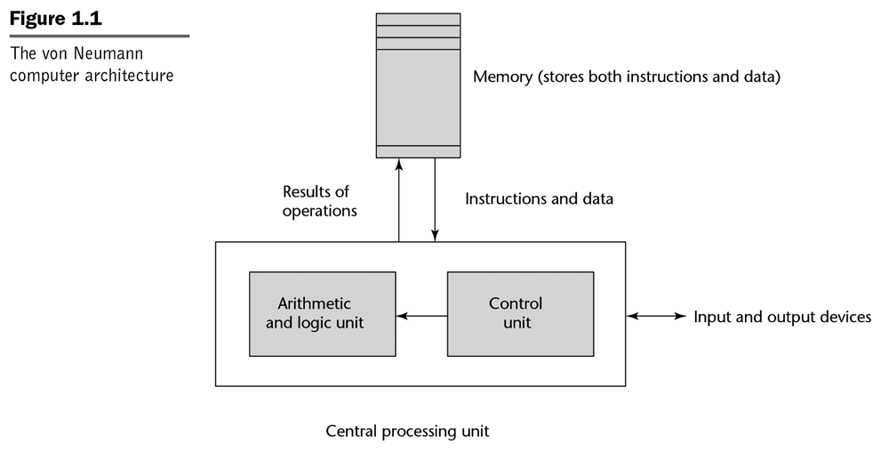
The Von Neumann Computer Architecture
Notes:
[Sebesta]
This is the (very) basic model of how most computers work
Quick Quiz – Mouse? Monitor? Where does division take place? DMA? Pipelining?

Slide 30
Other Computer Architectures
Harvard
separate data and program memories
Functional architectures
Symbolics, Lambda machine, Mago’s reduction machine
Logic architectures
Fifth generation computer project (1982-1992) and the PIM
Overall, alternate computer architectures have failed commercially
von Neumann machines get faster too quickly!
Notes:
Fifth Generation was a Japanese government research push (used Prolog) . Included a lot of parallelism. (PIM is a parallel inference machine). At least we have IBM Watson…
What is the effect of separate L1 caches on the advantages of Harvard? (VN bottleneck)

Slide 31
Language Design Goals
Reliability
writability
readability
simplicity
safety
robustness
Maintainability
factoring
locality
Efficiency
execution efficiency
referential transparency and optimization
optimizability: “the preoccupation with optimization should be removed from the early stages of programming… a series of [correctness-preserving and] efficiency-improving transformations should be supported by the language” [Ghezzi and Jazayeri]
software development process efficiency
effectiveness in the production of software
Notes:
Writeability vs. readability
(C vs. VB, also C vs. say SQL (with a DB) )
Expressiveness vs. clarity vs. terseness vs. verbosity
Robustness is being able to respond reasonably with bad data or input.
(Re-)Factoring is restructuring code – normally while maintaining its pre-existing functionality (for speed/stability/security/mantainability reasons).
Locality (Re: maintenance): Most data should be kept private (local) to a module – interfaces should be clean (to avoid tight coupling) is basically that the authors of code are the most able to repair bugs – you’re probably at the point where you find it easier to just write code than to read other people’s code (though that’s important too).

Slide 32
Language Translation
A source program in some source language is translated into an object program in some target language
An assembler translates from assembly language to machine language
A compiler translates from a high-level language into a low-level language
the compiler is written in its implementation language
An interpreter is a program that accepts a source program and runs it immediately
An interpretive compiler translates a source program into an intermediate language, and the resulting object program is then executed by an interpreter
Notes:
Translation = compilation/interpretive compilation (first stages, e.g. Java->bytecode)

Slide 33
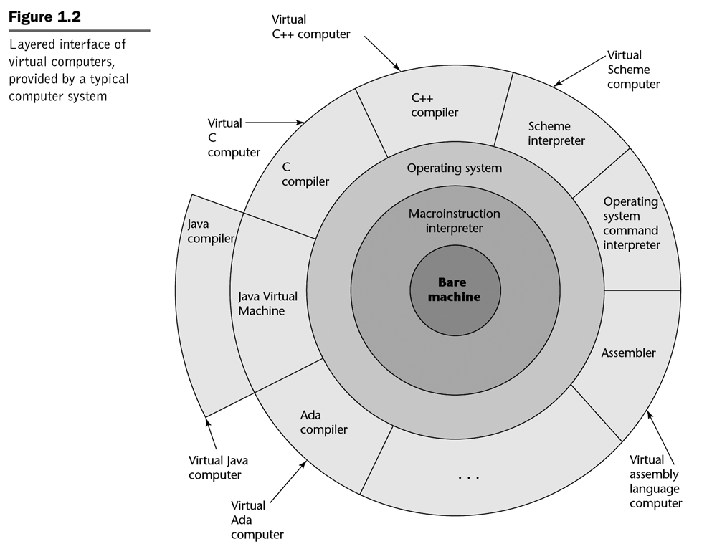
The Onion Model of Computers
Notes:
[Sebesta]
Macro instruction – 1 to 1+ instructions

Slide 34
Example of Language Translators
Compilers for Fortran, COBOL, C, C++
Interpretive compilers for Pascal (P-Code), Prolog (Warren Abstract Machine) and Java (Java Virtual Machine)
Interpreters for APL, Scheme, Haskell, Python, and (early) LISP

Slide 35
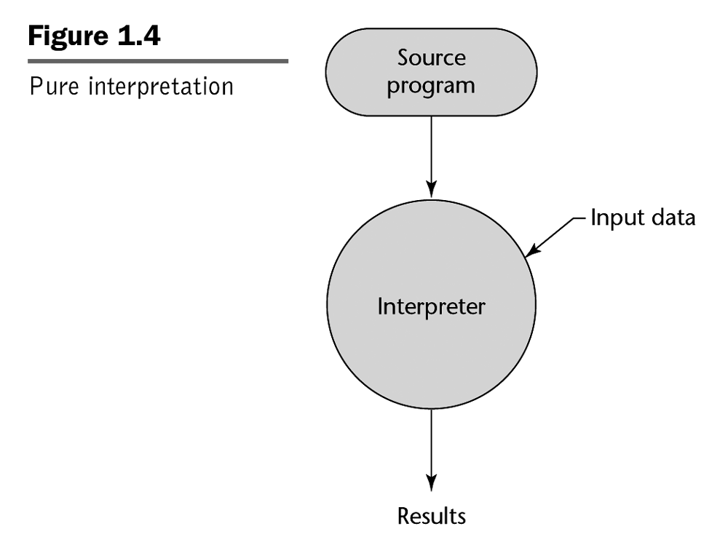
Notes:
[Sebesta]
Main difference is whether the code requires an interpreter to run (whether the interpreter or the program itself has its instructions executing on the CPU proper). Distinction is muddled with Just in Time compilation( bytecode is converted to native machine code which can then be run on CPU)

Slide 36
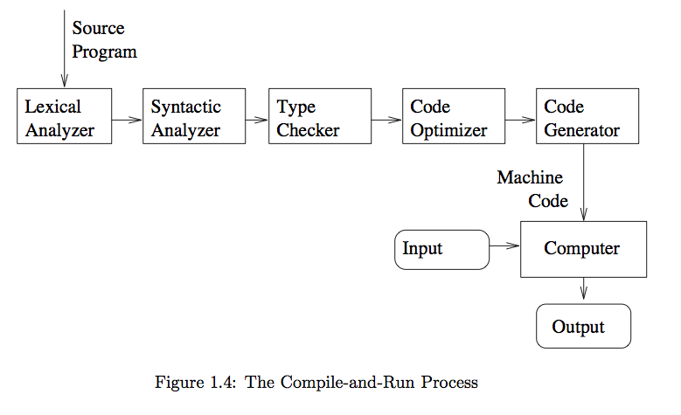

The Compiling Process
Notes:
[T]
(Compilers)
Lexical analyzer – tokenization
Syntactic YACC to Lex -- parsing
Type Checking: catches errors and also associates meaning with types (other properties). Also memory safety (especially in pointer languages – C/C++)

Slide 37
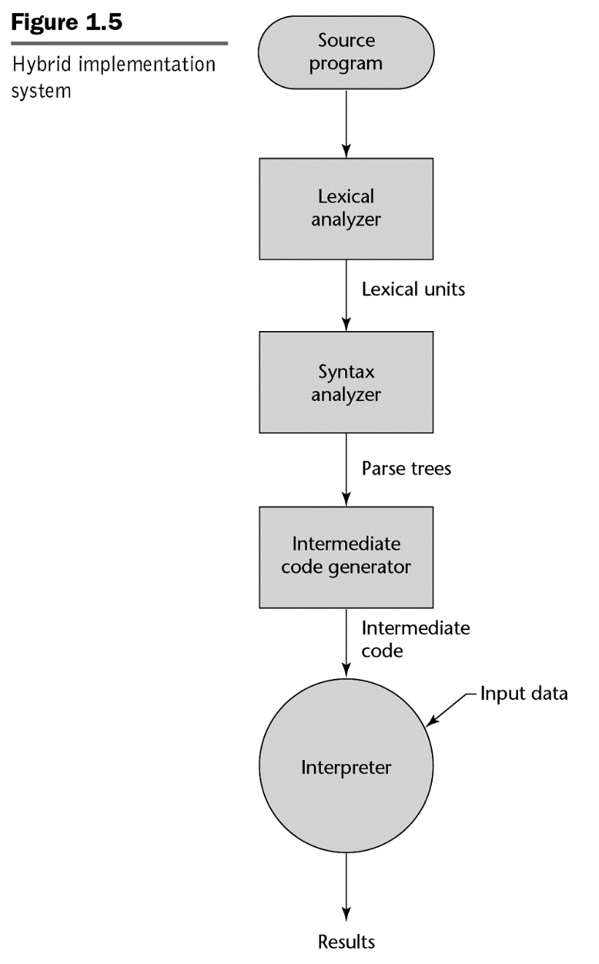
Hybrid Compilation and Interpretation
Notes:
[Sebesta]
JVM, basic version

Slide 38
Language Families
Imperative (or Procedural, or Assignment-Based)
Functional (or Applicative)
Logic (or Declarative)

Slide 39

Imperative Languages
Mostly influenced by the von Neumann computer architecture
Variables model memory cells, can be assigned to, and act differently from mathematical variables
Destructive assignment, which mimics the movement of data from memory to CPU and back
Iteration as a means of repetition is faster than the more natural recursion, because instructions to be repeated are stored in adjacent memory cells
Notes:
…modelled on a (simplified) machine (no registers, at least…)
…”variables” are really just named pieces of memory (very different from math variables – destructive assign.)
…iteration (vs. recursion) normal means of repetition (remember: can typically convert between the two)
… also tail-call optimization (recursion to iteration
… in imperative langs have to specify HOW to get WHAT you want (func/declarative this is less true)

Slide 40
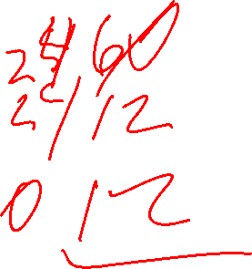
GCD (Euclid’s Algorithm) in C
To compute the gcd of a and b, check to see if a and b are equal. If so, print one of them and stop. Otherwise, replace the larger one by their difference and repeat.
#include <stdio.h>
int gcd(int a, int b) {
while ( a>0 && b>0 ) {
if (a > b) a = a%b;
else b = b%a;
}
return max(a,b);
}
Notes:
[S] Also:
int main()
{
int i, j;
scanf("%d %d", &i, &j);
printf("%d\n", gcd(i, j));
}
Note that this is the difference version… not same as % version ( gcd (10000000,1) )

Slide 41
Logic/Declarative Languages
Model of computation is the Post production system
Write-once variables
Rule-based programming
Related to Horn logic, a subset of first-order logic
AND and OR non-determinism can be exploited in parallel execution
Almost unbelievably simple semantics
Prolog is a compromise language: not a pure logic language
Notes:
Horn clause – disjunction of literals, at most one positive
Write-once doesn’t mean can’t change (more later with back-tracking)

Slide 42
GCD (Euclid’s Algorithm) in Prolog
The proposition gcd(a,b,g) is true if (a) a,b, and g are equal; (2) a is greater than b and there exists a number c such that c is a-b and gcd(c,g,b) is true; or (3) a is less than b and there exists a number c such that c is b-a and gcd(c,a,g) is true. To compute the gcd of a given pair of numbers, search for a number g (and various numbers c) for which these rules allow one to prove that gcd(a,b,g) is true
gcd(A,B,G) :- A = 0, G = B.
gcd(A,B,G) :- B = 0, G = A.
gcd(A,B,G) :- A > B, \+(B=0), C is mod(A,B), gcd(C,B,G).
gcd(A,B,G) :- B > A, \+(A=0),C is mod(B,A), gcd(C,A,G).
Notes:
Note:
Way to interpret:
if A==B, then gcd is A (or b…)
if A>B…
Note recursion here
No real control structure (just rules and guards). Can reorder the clauses however you want.
gcd(20,5)

Slide 43
Functional Languages
Model of computation is the lambda calculus (of function application)
No variables or write-once variables
No destructive assignment
Program computes by applying a functional form to an argument
Program are built by composing simple functions into progressively more complicated ones
Recursion is the preferred means of repetition
Notes:
Functional Languages eschew destructive assignment, can be considered a type of declarative language
Avoid “state”
Functions should be pure – have no side effects (the inputs/parameters ALONE should determine output)
We’ll talk about this later, Haskell, but there are ways of dealing with this
Composing functions (some of which are higher-order – map, e.g. takes a function and applies it to a list – replace a loop (complicated control structure) with a function call. Very clean.
Alonzo Church –
Lambda calculus useful for small functions (for sorting lists etc. in c++11, also anonymous functions, e.g..
Useful for formal analysis of algorithms and computation in general.
L = lamda Lx.Ly.x^3*y^2
lambda is the term for an anonymous (lambda (n)(*n n n )) http://homepage.cs.uiowa.edu/~slonnegr/plf/Book/Chapter5.pdf
Page 6 [h] for Haskell version.

Slide 44

GCD (Euclid’s Algorithm) in Scheme
The gcd of a and b is defined to be (1) a when a and b are equal, (2) the gcd of b and a-b when a > b and (3) the gcd of a and b-a when b > a. To compute the gcd of a given pair of numbers, expand and simplify this definition until it terminates
(define gcd2 ; 'gcd' is built-in to R5RS
(lambda (a b)
(cond ((= a 0) b)
((= b 0) a)
((> a b) (gcd2 (modulo a b) b))
(else (gcd2 (modulo b a) a)))))

Slide 45
Some Historical Perspective
“Every programmer knows there is one true programming language. A new one every week.”
Brian Hayes, “The Semicolon Wars.” American Scientist, July-August 2006, pp.299-303
http://www.americanscientist.org/template/AssetDetail/assetid/51982#52116
Language families
Evolution and Design

Slide 46
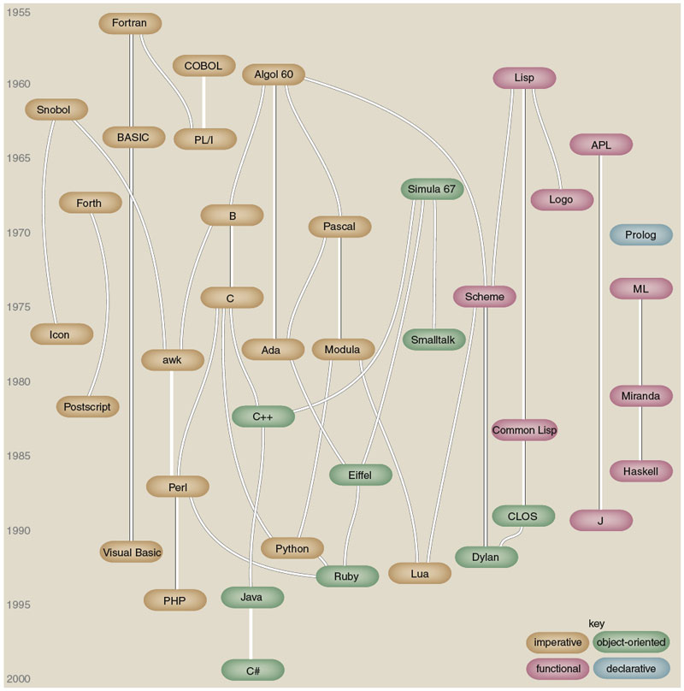
Figure by Brian Hayes (who credits, in part, Éric Lévénez and Pascal Rigaux): Brian Hayes, “The Semicolon Wars.” American Scientist, July-August 2006, pp.299-303
Notes:
Also see figure A.1 in [S], p.820.

Slide 47
Some Historical Perspective
Plankalkül (Konrad Zuse, 1943-1945)
FORTRAN (John Backus, 1956)
LISP (John McCarthy, 1960)
ALGOL 60 (Transatlantic Committee, 1960)
COBOL (US DoD Committee, 1960)
APL (Iverson, 1962)
BASIC (Kemeny and Kurz, 1964)
PL/I (IBM, 1964)
SIMULA 67 (Nygaard and Dahl, 1967)
ALGOL 68 (Committee, 1968)
Pascal (Niklaus Wirth, 1971)
C (Dennis Ritchie, 1972)
Prolog (Alain Colmerauer, 1972)
Smalltalk (Alan Kay, 1972)
FP (Backus, 1978)
Ada (UD DoD and Jean Ichbiah, 1983)
C++ (Stroustrup, 1983)
Modula-2 (Wirth, 1985)
Delphi (Borland, 1988?)
Modula-3 (Cardelli, 1989)
ML (Robin Milner, 1978)
Haskell (Committee, 1990)
Eiffel (Bertrand Meyer, 1992)
Java (Sun and James Gosling, 1993?)
C# (Microsoft, 2001?)
Scripting languages such as Perl, etc.
Etc.

Slide 48
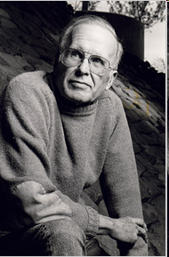

Alain Colmerauer and John Backus
Alain Colmerauer (1941-2017), the creator of Prolog
John Backus (1924-2007), the creator of FP
Notes:
http://alain.colmerauer.free.fr/, accessed 2010-08-17
http://en.wikipedia.org/wiki/John_Backus and http://www.nytimes.com/2007/03/20/business/20backus.html?_r=2&hp&oref=slogin accessed 2010-08017, accessed 2010-08-17
Backus was also involved with Fortran (head of team).

Slide 49
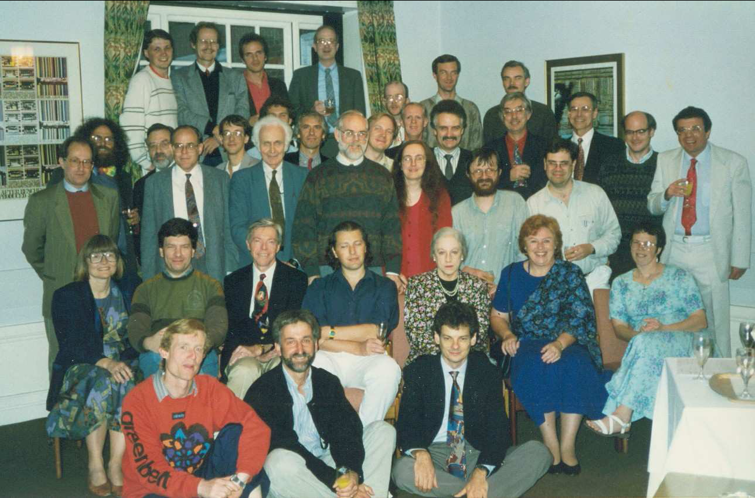
Haskell committee, 1992---history from www.haskell.org

Slide 50
Haskell Timeline

Slide 51
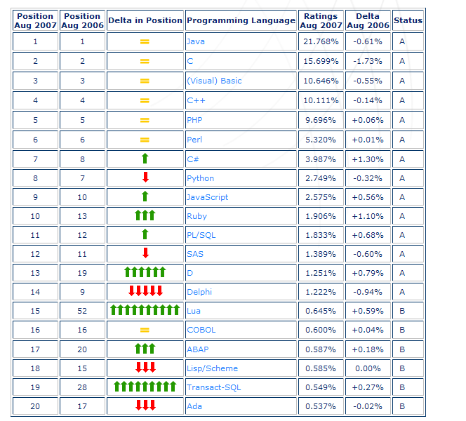
August 2007 Tiobe PL Index
Notes:
Source: http://www.tiobe.com/index.htm?tiobe_index accessed on 2007-08-23
Ruby, D

Slide 52
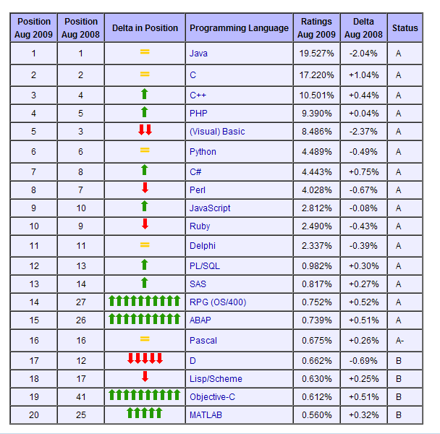
August 2009 Tiobe PL Index
Notes:
Objective-C
MATLAB

Slide 53
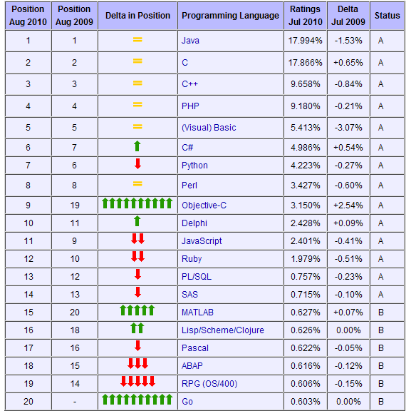
August 2010 Tiobe PL Index
Notes:
http://www.tiobe.com/index.php/content/paperinfo/tpci/index.html, accessed 2010-08-17. Haskell is #36 (between Fortran and Logo), Prolog is #43, ML is #45, and Caml/F# is #47.

Slide 54
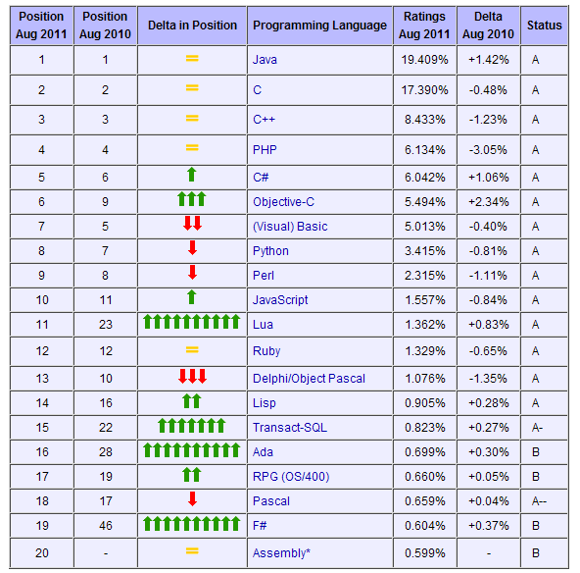
August 2011 Tiobe PL Index
Notes:
http://www.tiobe.com/index.php/content/paperinfo/tpci/index.html, accessed 2010-08-11. Haskell is #35, Prolog is #50, Fortran is #24ML is #45, and Caml/F# is #47. From the same site, accessed 2011-08-11: Q: How come that Assembly is so popular nowadays? A: It seems as if Assembly is new in the top 20. This is not the case. Through the years we had a lot of discussions with followers of the index whether Assembly should be part of the index or not. Until now we could convince them to leave Assembly out. However, recently we defined objective criteria to qualify for the index and Assembly appeared to meet these criteria. So we added Assembly at the end of 2010. Since no historical data is available, it seems as if it comes out of nowhere, whereas it was probably in the past at least as popular as it is now.

Slide 55
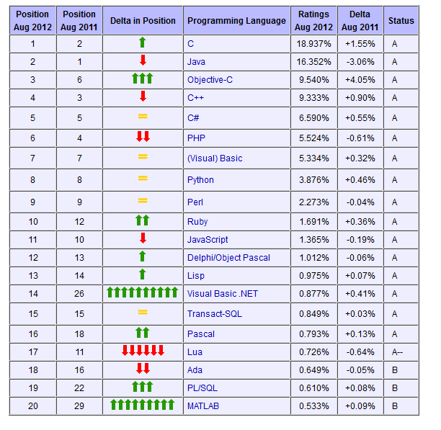
August 2012 Tiobe PL Index
Notes:
http://www.tiobe.com/index.php/content/paperinfo/tpci/index.html, accessed 2012-08-23. Haskell is #34 (was #35 in August 2011), Prolog is #31 (was #50 in August 2011), Fortran is #26. ML is #45, and Caml/F# is #47.
MATLAB is back

Slide 56
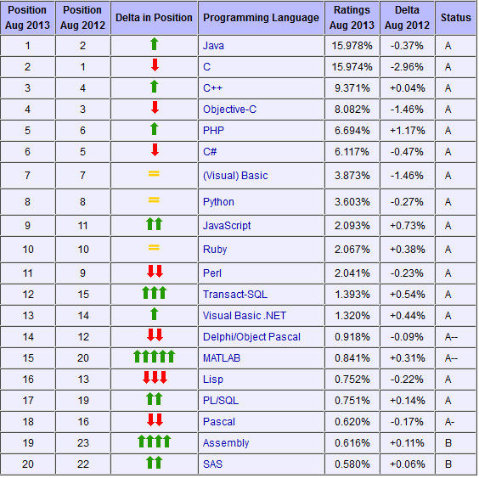
August 2013 Tiobe PL Index
Notes:
Accessed 2013-08-20. Haskell is #34 (was #34 in August 2012), Prolog is #36 (was #31 in August 2012), Fortran is #31, and ML is #40.

Slide 57
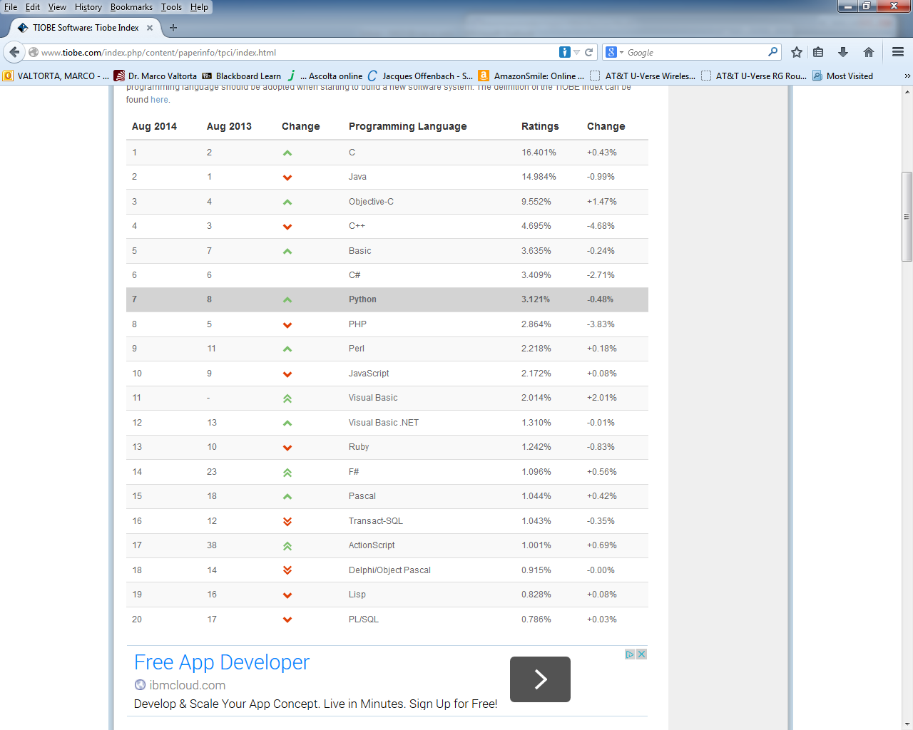
August 2014 Tiobe PL Index
Notes:
Accessed 2014-08-21. Haskell is #40 (was #34 in August 2013 and 2012), Prolog is #46 (was #36 in August 2013, #31 in August 2012), Fortran is #34, and ML is #25.

Slide 58
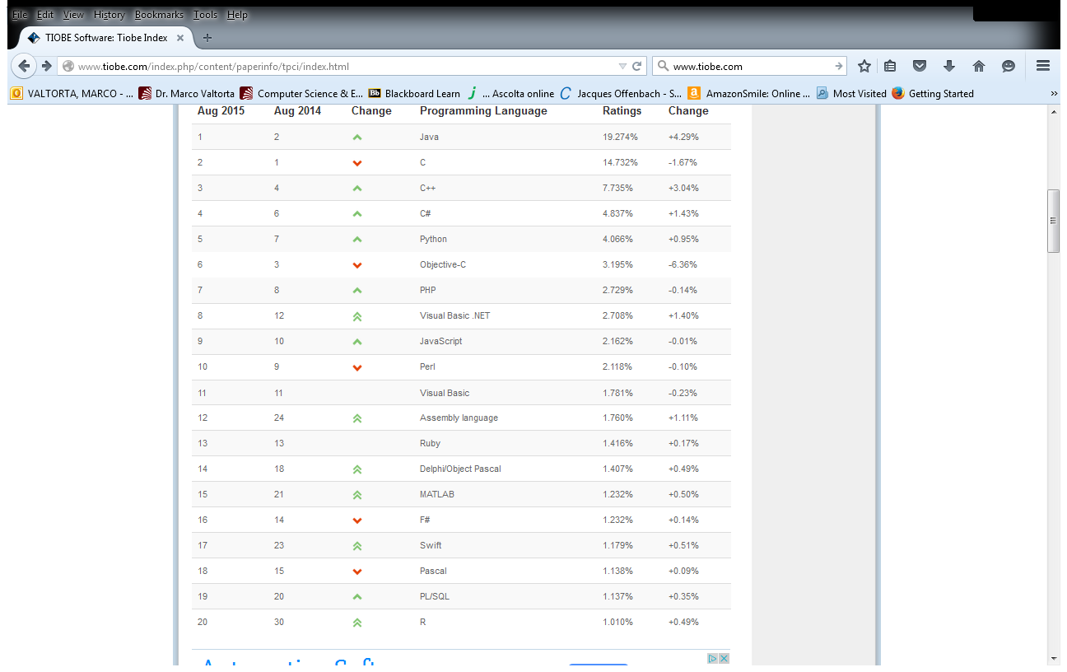
August 2015 Tiobe PL Index
Notes:
Accessed 2014-08-18. Haskell is #41 (was #40 in August 2014, #34 in August 2013 and 2012), Prolog is #32 (was #46 in August 2014, #36 in August 2013, #31 in August 2012), Fortran is #24 (was #34 in August 2014), and ML is #46.

Slide 59
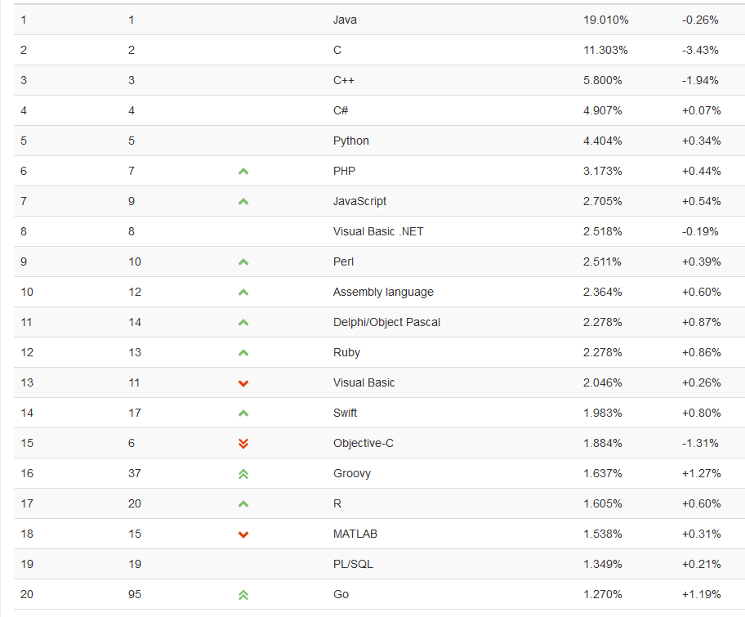
August 2016 Tiobe PL Index
Notes:
Accessed 2016-08-17. Haskell is #39 (was #41 in August 2015, #40 in August 2014, #34 in August 2013 and 2012), Prolog is #33 (was #32 in August 2015, #46 in August 2014, #36 in August 2013, #31 in August 2012), Fortran is #28 (was #24 in August 2015, #34 in August 2014), and ML is in the 51-100 range (was #46 in August 2015).

Slide 60
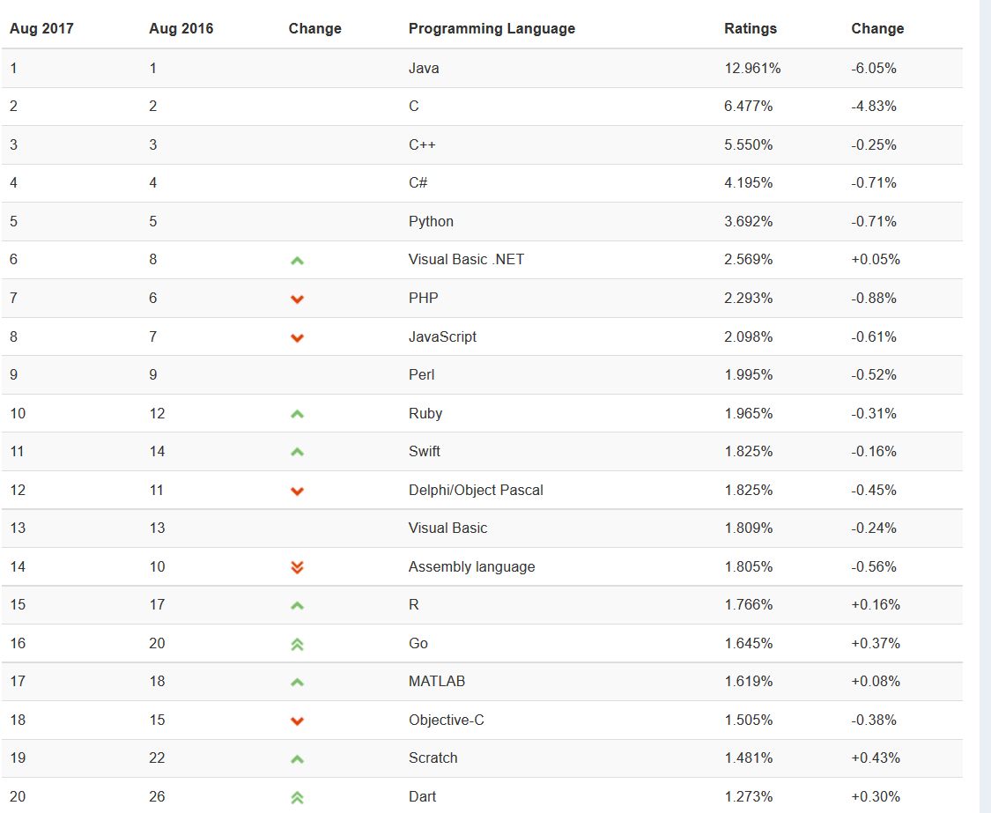
August 2017 Tiobe PL Index
Notes:
Accessed 2017-08-23. Haskell is #47 (was #39 in August 2016, #41 in August 2015, #40 in August 2014, #34 in August 2013 and 2012), Prolog is #30 (was #33 in August 2016, #32 in August 2015, #46 in August 2014, #36 in August 2013, #31 in August 2012), Fortran is #35 (was #28 in August 2016, #24 in August 2015, #34 in August 2014), and ML is in the 51-100 range (was in that range in August 2016, #46 in August 2015).

Slide 61
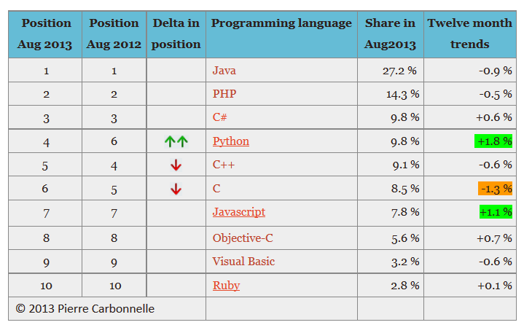
August 2013 PYPL Index
Notes:
PYPL is a competing (with respect to Tiobe)PL popularity index. This chart and the commentary below were downloaded on 2013-08-15 from https://sites.google.com/site/pydatalog/pypl/PyPL-PopularitY-of-Programming-Language.
Tiobe is based on #engineers, courses, thirdparty vendors ( sarroutbi-fsw.blogspot.com (15/24/8)
The PYPL PopularitY of Programming Language index is created by analyzing how often language tutorials are searched on Google : the more a specific language tutorial is searched, the more popular the language is assumed to be. It is a leading indicator. The raw data comes from Google Trends, so that anyone can verify it, or make the analysis for his own country.

Slide 62
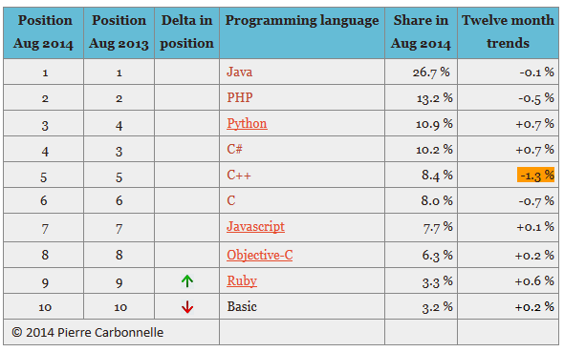
August 2014 PYPL Index
Notes:
PYPL is a competing (with respect to Tiobe) PL popularity index. This chart and the commentary below were downloaded on 2014-08-19 from https://sites.google.com/site/pydatalog/pypl/PyPL-PopularitY-of-Programming-Language.
The PYPL PopularitY of Programming Language index is created by analyzing how often language tutorials are searched on Google : the more a specific language tutorial is searched, the more popular the language is assumed to be. It is a leading indicator. The raw data comes from Google Trends, so that anyone can verify it, or make the analysis for his own country.

Slide 63
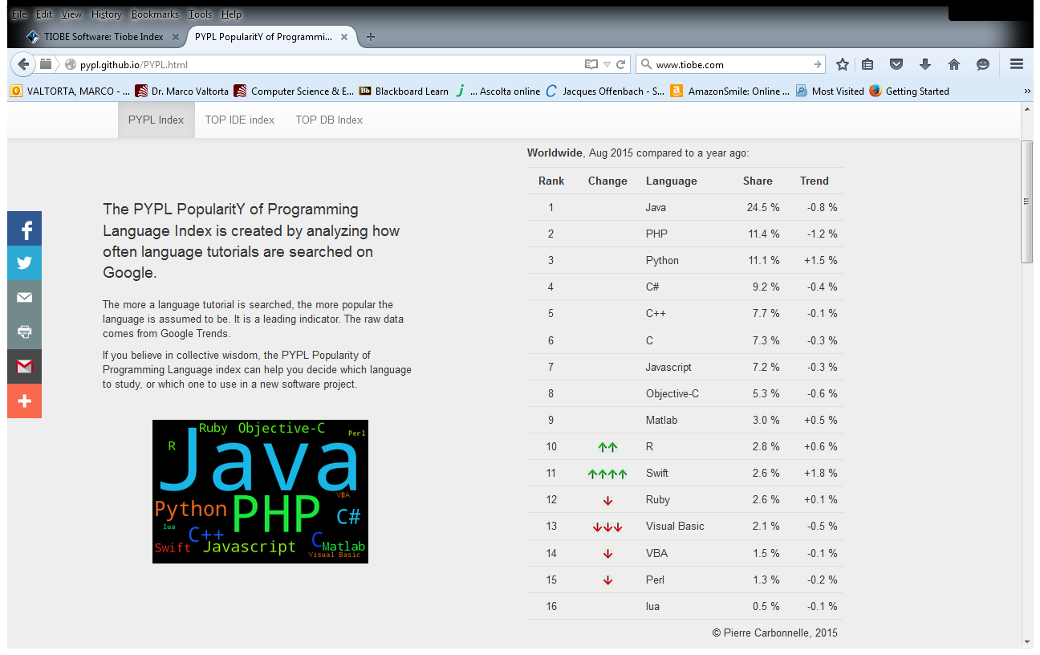
August 2015 PYPL Index
Notes:
PYPL is a competing (with respect to Tiobe) PL popularity index. This chart and the commentary below were downloaded on 2015-08-18 from http://pypl.github.io/PYPL.html. The site includes a custom search engine to construct charts and graphs for specific languages and geographic regions. The PYPL PopularitY of Programming Language index is created by analyzing how often language tutorials are searched on Google : the more a specific language tutorial is searched, the more popular the language is assumed to be. It is a leading indicator. The raw data comes from Google Trends, so that anyone can verify it, or make the analysis for his own country.

Slide 64
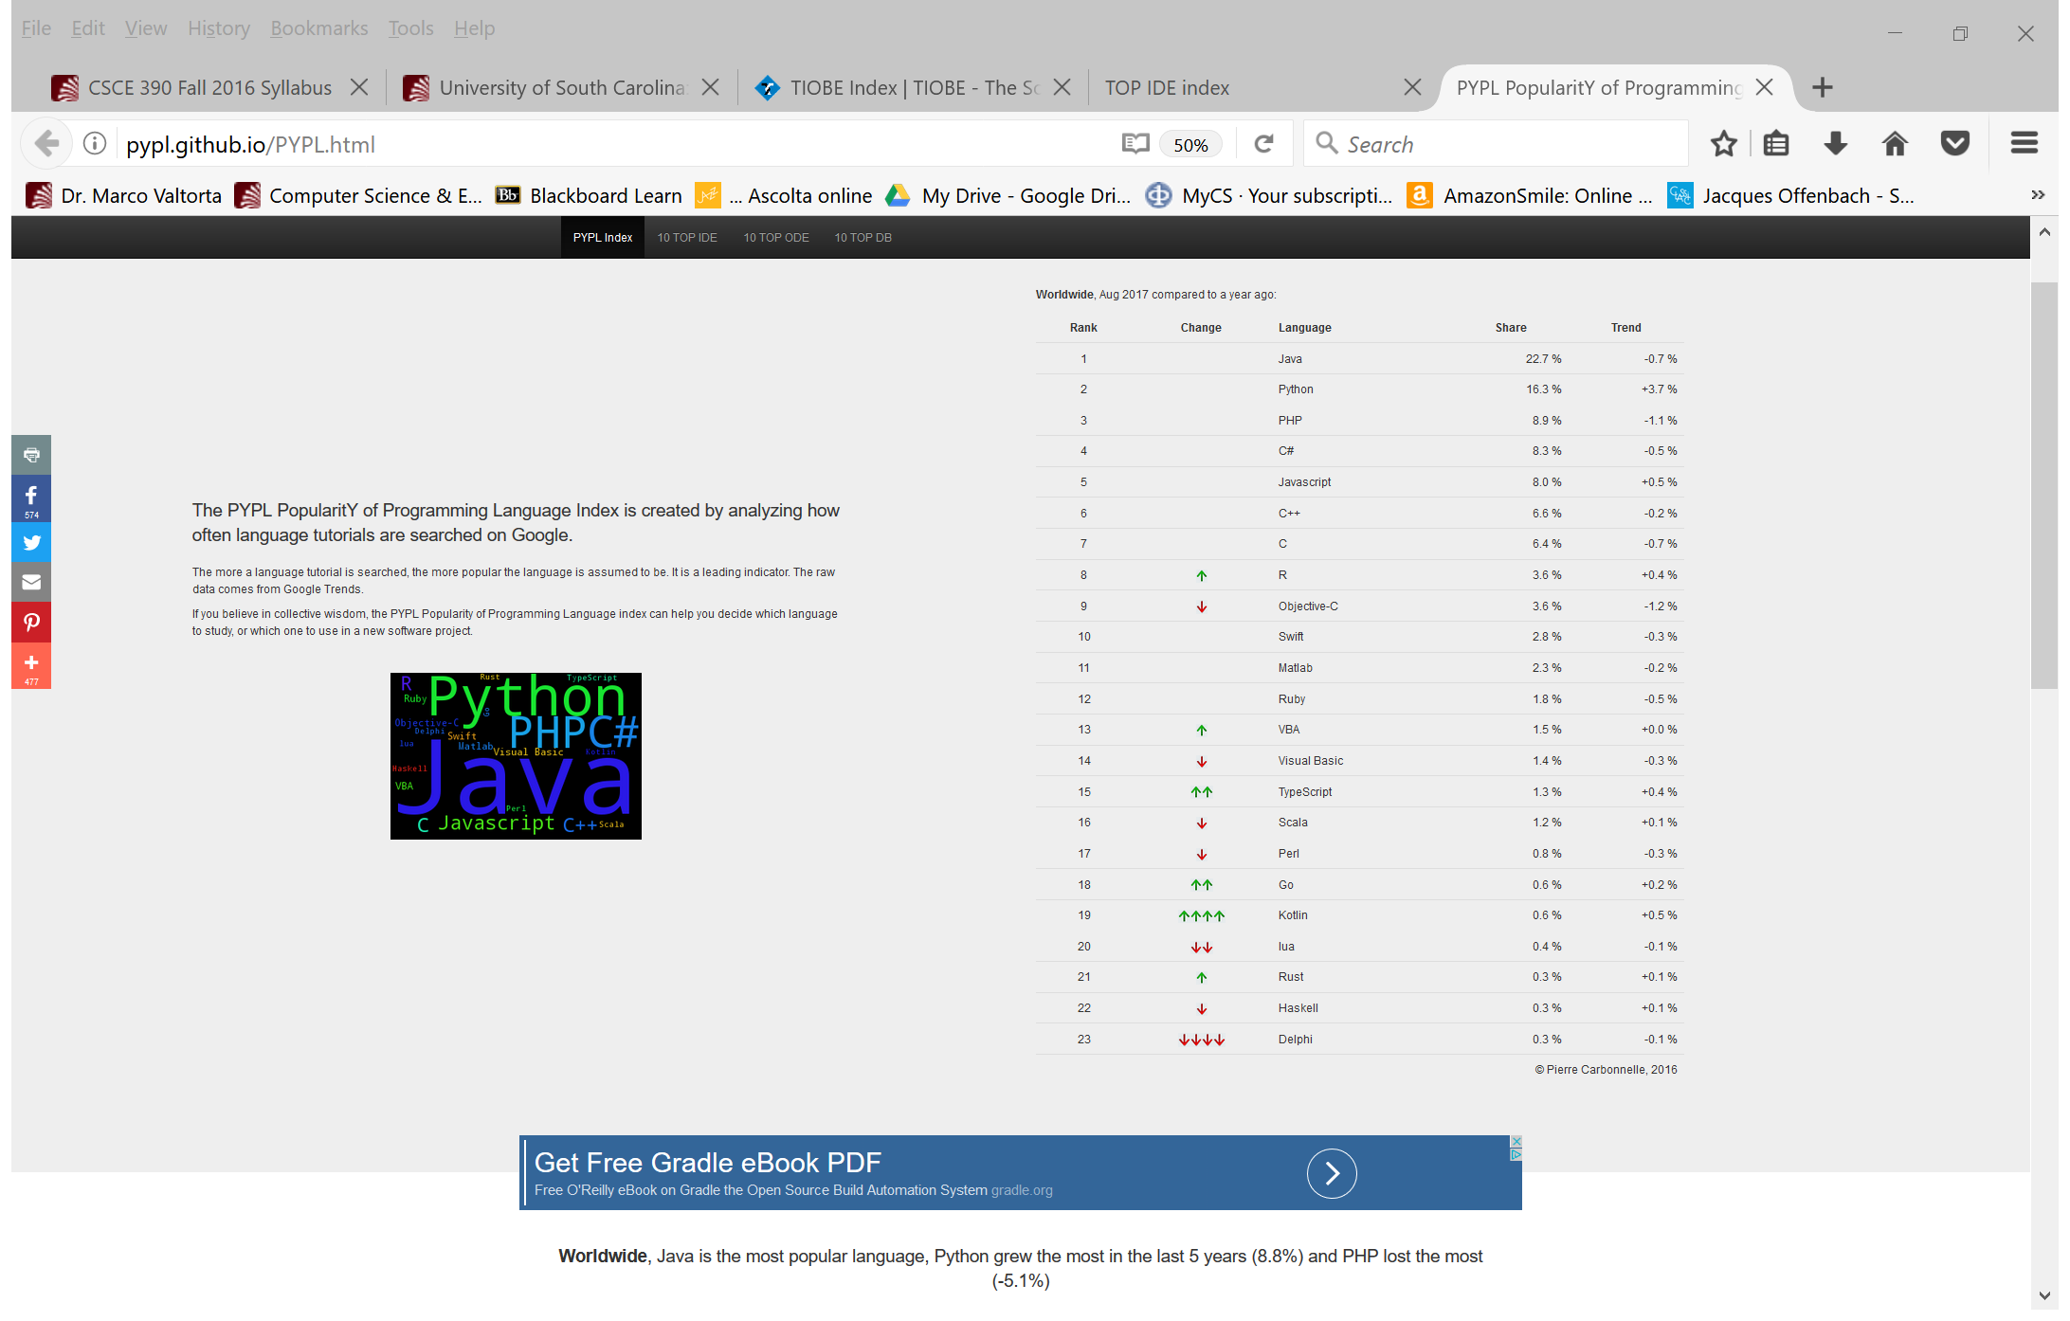
August 2017 PYPL Index
Notes:
PYPL is a competing (with respect to Tiobe) PL popularity index. This chart and the commentary below were downloaded on 2017-08-23 from http://pypl.github.io/PYPL.html. The site includes a custom search engine to construct charts and graphs for specific languages and geographic regions. The PYPL PopularitY of Programming Language index is created by analyzing how often language tutorials are searched on Google : the more a specific language tutorial is searched, the more popular the language is assumed to be. It is a leading indicator. The raw data comes from Google Trends, so that anyone can verify it, or make the analysis for his own country.

Slide 65
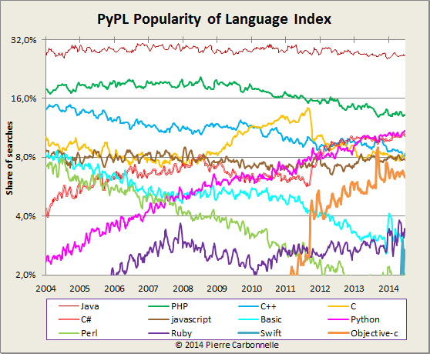
August 2014 PYPL Long-Term Index
Notes:
PYPL is a competing (with respect to Tiobe) PL popularity index. This chart and the commentary below were downloaded on 2014-08-19 from https://sites.google.com/site/pydatalog/pypl/PyPL-PopularitY-of-Programming-Language.
The PYPL PopularitY of Programming Language index is created by analyzing how often language tutorials are searched on Google : the more a specific language tutorial is searched, the more popular the language is assumed to be. It is a leading indicator. The raw data comes from Google Trends, so that anyone can verify it, or make the analysis for his own country.

Slide 66
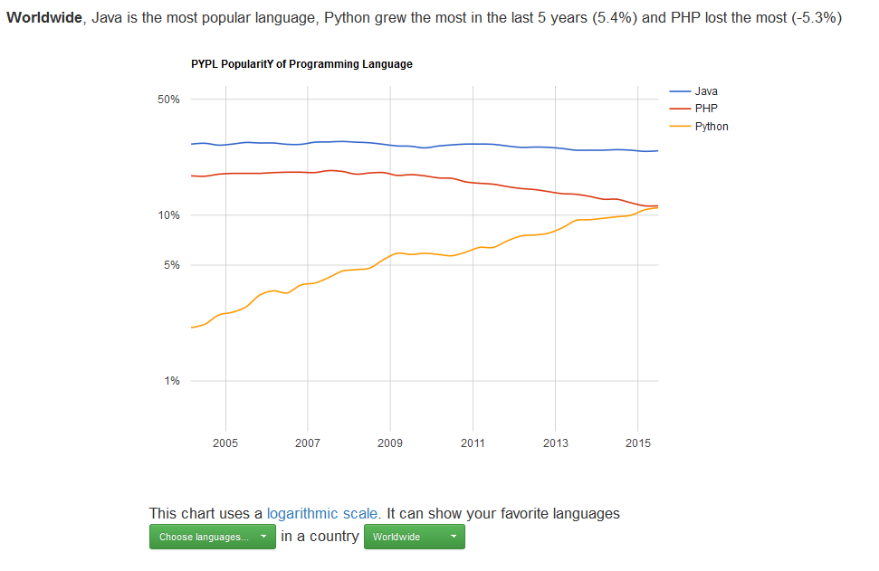
August 2015 PYPL Long-Term Index
Notes:
PYPL is a competing (with respect to Tiobe) PL popularity index. This chart and the commentary below were downloaded on 2015-08-18 from http://pypl.github.io/PYPL.html. The site includes a custom search engine to construct charts and graphs for specific languages and geographic regions. The PYPL PopularitY of Programming Language index is created by analyzing how often language tutorials are searched on Google : the more a specific language tutorial is searched, the more popular the language is assumed to be. It is a leading indicator. The raw data comes from Google Trends, so that anyone can verify it, or make the analysis for his own country.

Slide 67
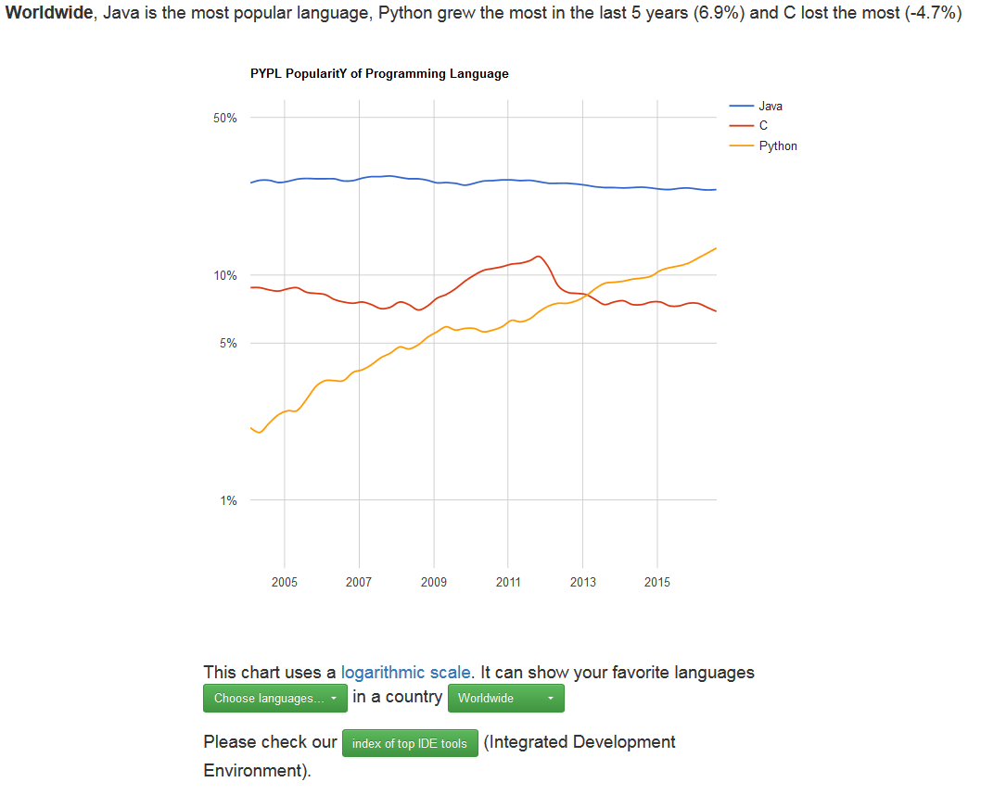
August 2016 PYPL Long-Term Index
Notes:
PYPL is a competing (with respect to Tiobe) PL popularity index. This chart and the commentary below were downloaded on 2016-08-17 from http://pypl.github.io/PYPL.html. The site includes a custom search engine to construct charts and graphs for specific languages and geographic regions. The PYPL PopularitY of Programming Language index is created by analyzing how often language tutorials are searched on Google : the more a specific language tutorial is searched, the more popular the language is assumed to be. It is a leading indicator. The raw data comes from Google Trends, so that anyone can verify it, or make the analysis for his own country. The table is covered by the Creative Commons Attribution 3.0 Unported License (https://creativecommons.org/licenses/by/3.0/).

Slide 68
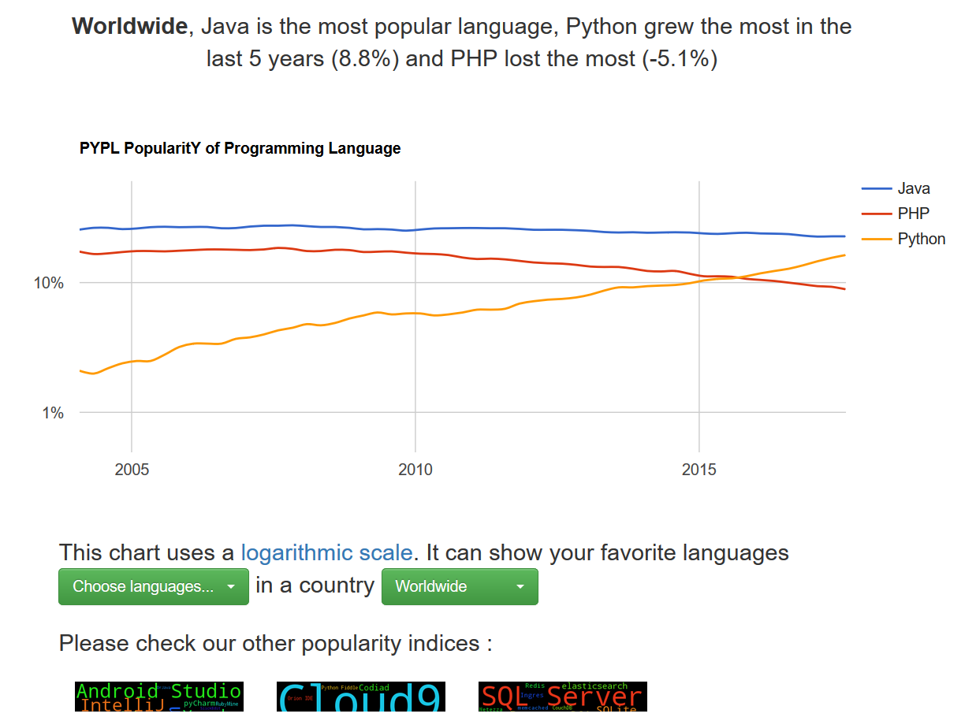
August 2017 PYPL Long-Term Index
Notes:
PYPL is a competing (with respect to Tiobe) PL popularity index. This chart and the commentary below were downloaded on 2017-08-23 from http://pypl.github.io/PYPL.html. The site includes a custom search engine to construct charts and graphs for specific languages and geographic regions. The PYPL PopularitY of Programming Language index is created by analyzing how often language tutorials are searched on Google : the more a specific language tutorial is searched, the more popular the language is assumed to be. It is a leading indicator. The raw data comes from Google Trends, so that anyone can verify it, or make the analysis for his own country. The table is covered by the Creative Commons Attribution 3.0 Unported License (https://creativecommons.org/licenses/by/3.0/).

Slide 69
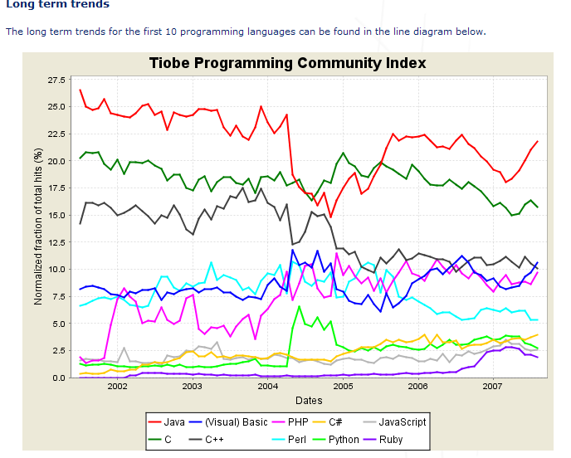
Tiobe Index Long Term Trends, August 2007
Notes:
The end of 2004 drop for Java is due to a change in Google. See http://www.tiobe.com/index.htm?tiobe_index, accessed on 2007-08-23.

Slide 70
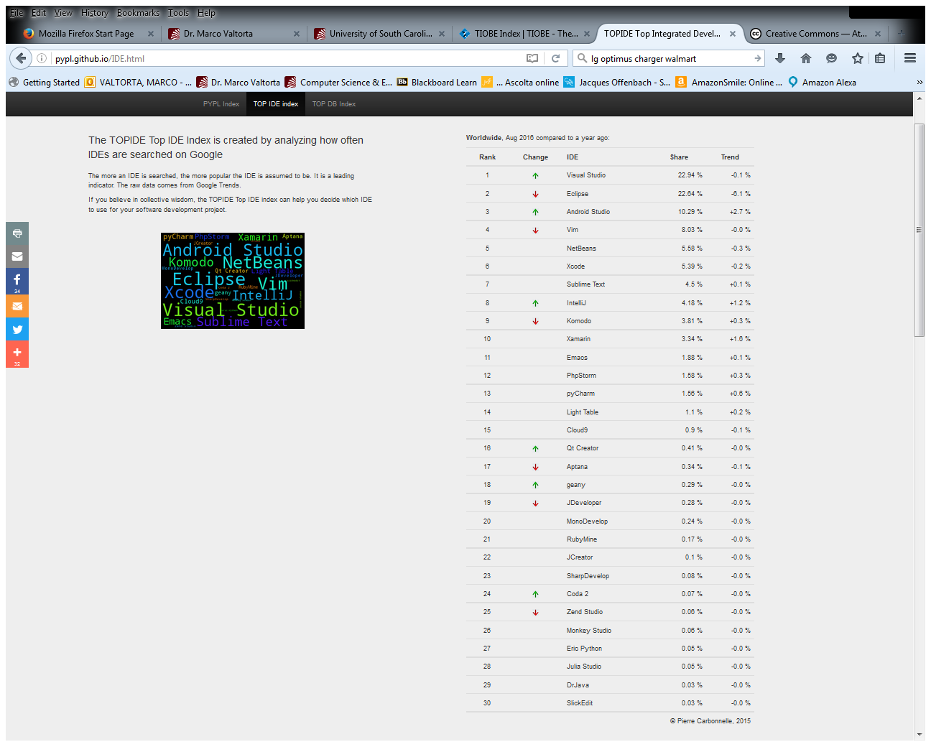
TOPIDE Top IDE Index, August 2016
Notes:
http://pypl.github.io/IDE.html, accessed 2016-08-17.

Slide 71
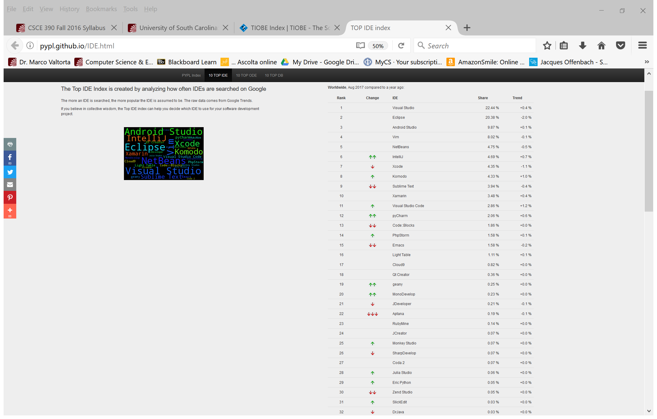
TOPIDE Top IDE Index, August 2017
Notes:
http://pypl.github.io/IDE.html, accessed 2016-08-17.

Slide 72
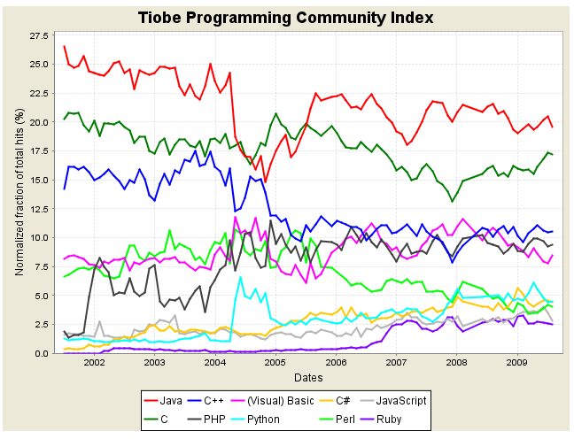
Tiobe Index Long Term Trends, August 2009
Notes:
The end of 2004 drop for Java is due to a change in Google. See http://www.tiobe.com/index.htm?tiobe_index, accessed on 2007-08-23.

Slide 73
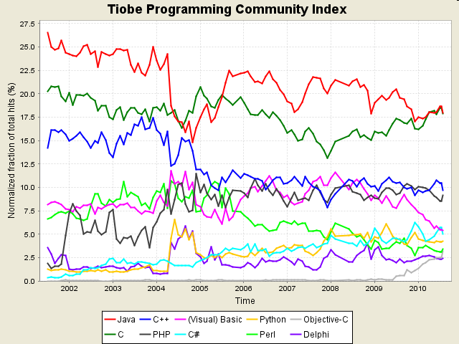
Tiobe Index Long Term Trends, August 2010
Notes:
http://www.tiobe.com/index.php/content/paperinfo/tpci/index.html, accessed 2010-08-17. The end of 2004 drop for Java is due to a change in Google. See http://www.tiobe.com/index.htm?tiobe_index, accessed on 2007-08-23.

Slide 74
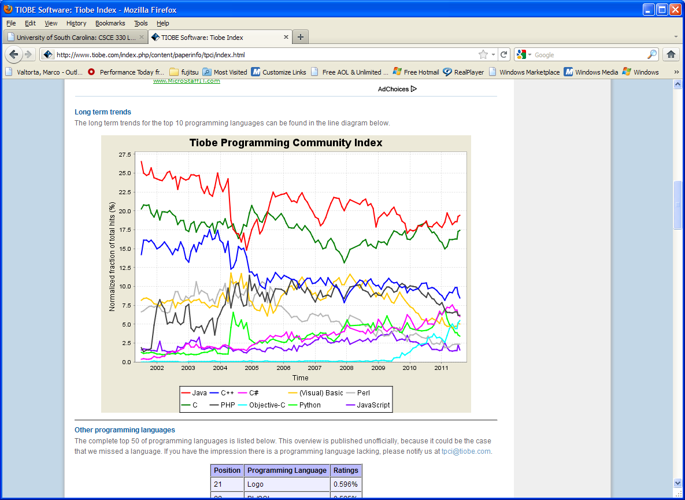
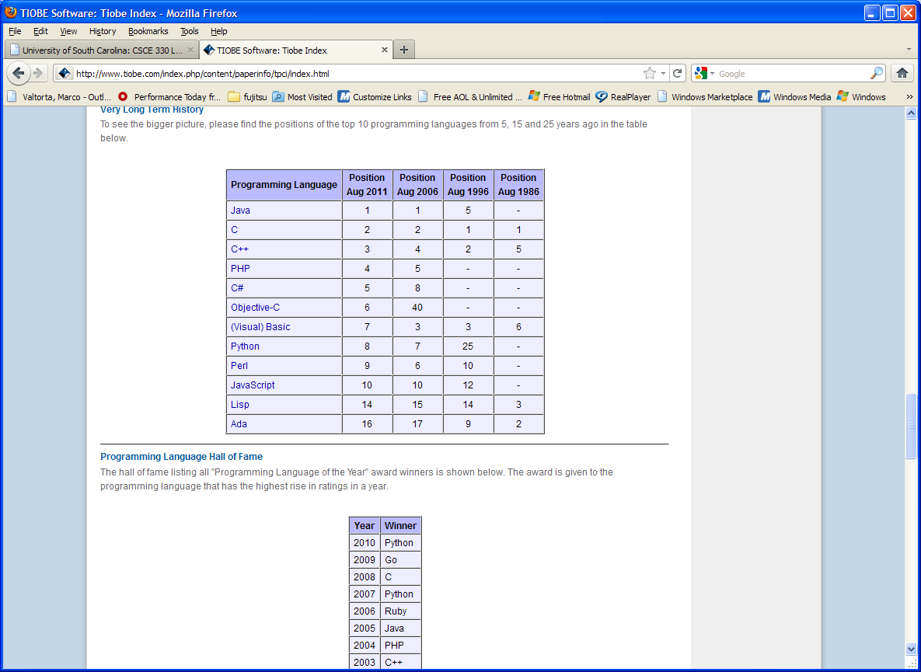
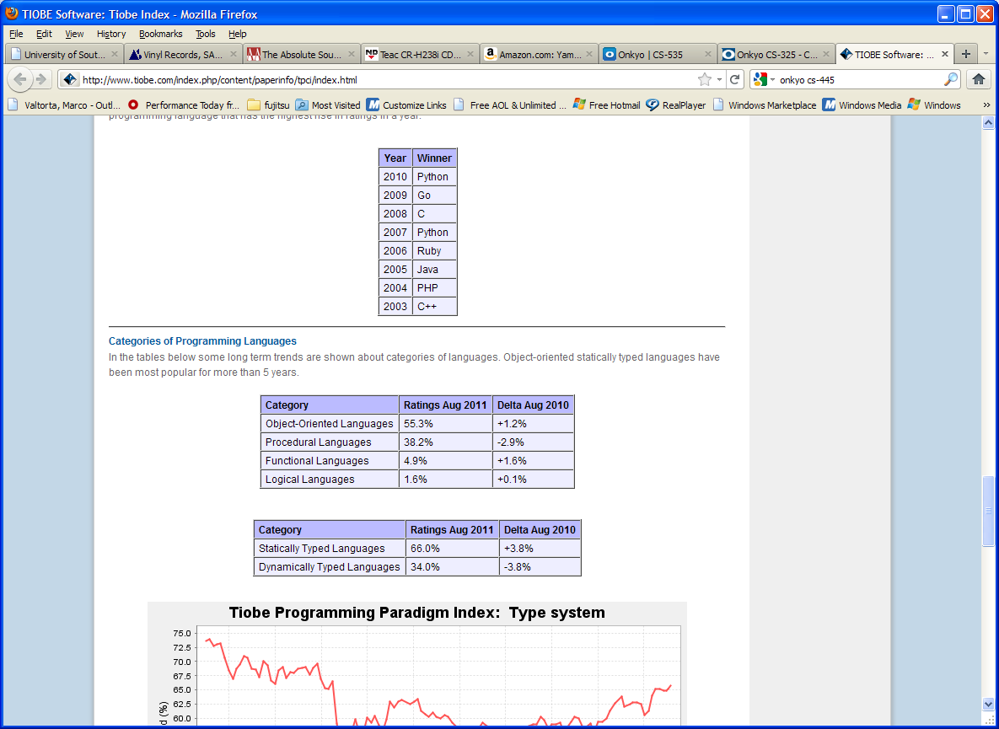
Tiobe Index Long Term Trends, August 2011
Notes:
http://www.tiobe.com/index.php/content/paperinfo/tpci/index.html, accessed 2010-08-11. The end of 2004 drop for Java is due to a change in Google. See http://www.tiobe.com/index.htm?tiobe_index, accessed on 2007-08-23.
Static vs. Dynamic Typing will be explained in a later lecture.

Slide 75
Tiobe Index Long Term Trends, August 2011
Notes:
http://www.tiobe.com/index.php/content/paperinfo/tpci/index.html, accessed 2010-08-23. The end of 2004 drop for Java is due to a change in Google. See http://www.tiobe.com/index.htm?tiobe_index, accessed on 2007-08-23.
Static vs. Dynamic Typing will be explained in a later lecture.

Slide 76
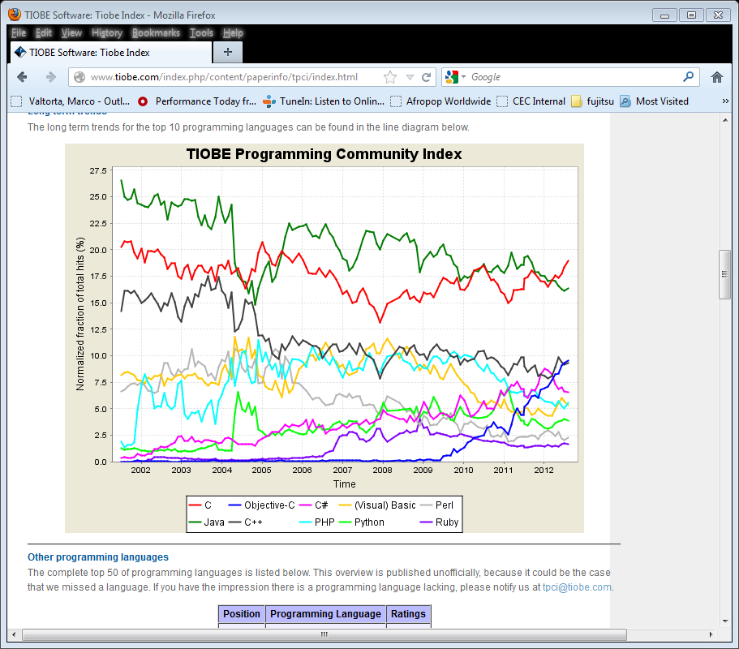
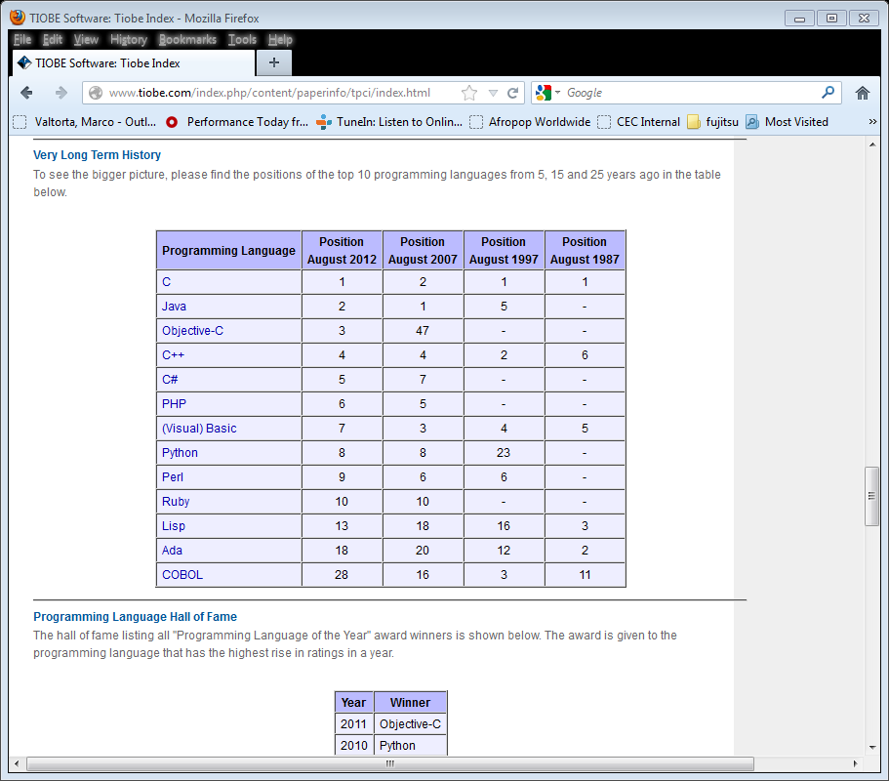
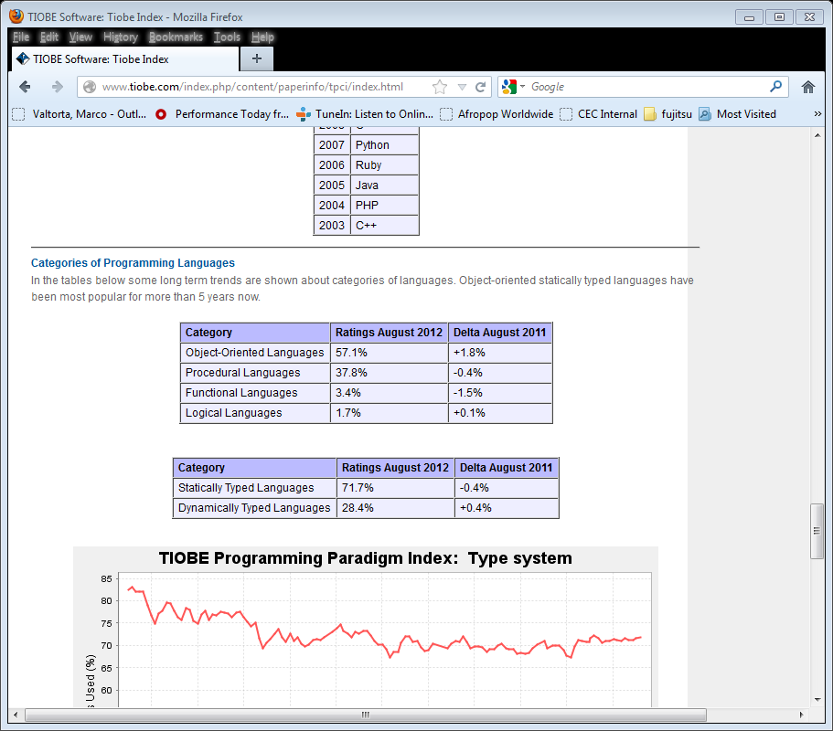
Tiobe Index Long Term Trends, August 2012
Notes:
http://www.tiobe.com/index.php/content/paperinfo/tpci/index.html, accessed 2012-08-23. The end of 2004 drop for Java is due to a change in Google. See http://www.tiobe.com/index.htm?tiobe_index, accessed on 2007-08-23.
Static vs. Dynamic Typing will be explained in a later lecture.

Slide 77
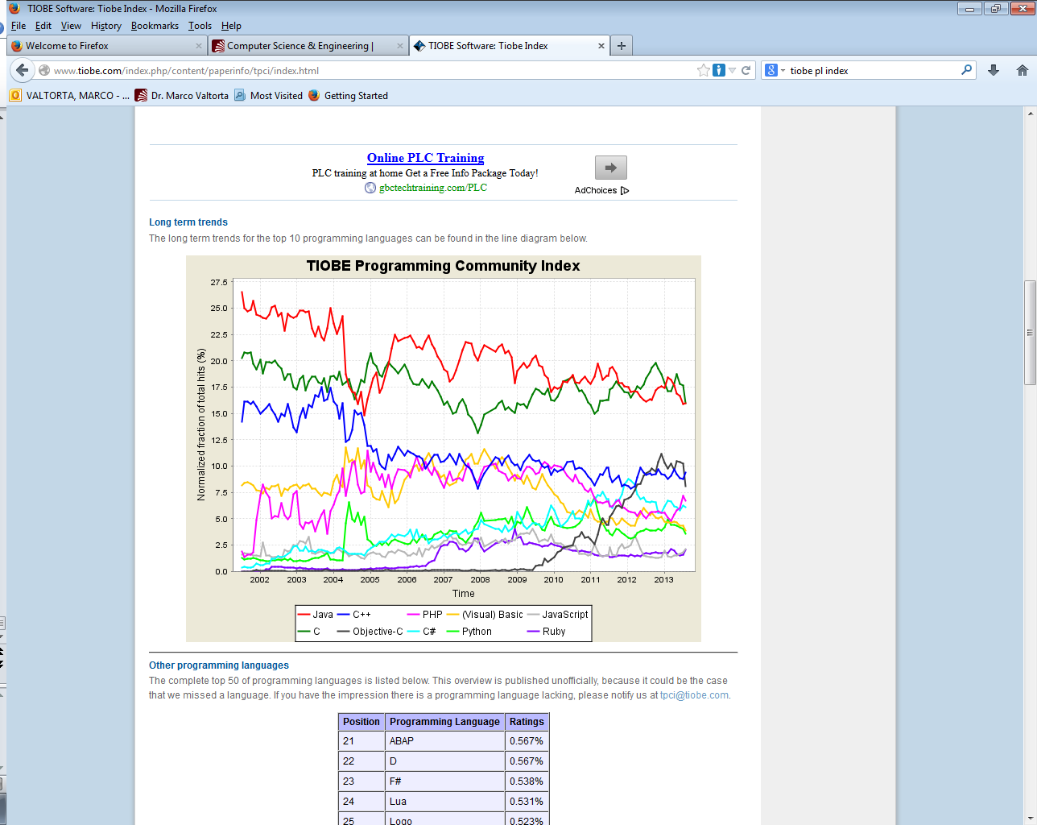
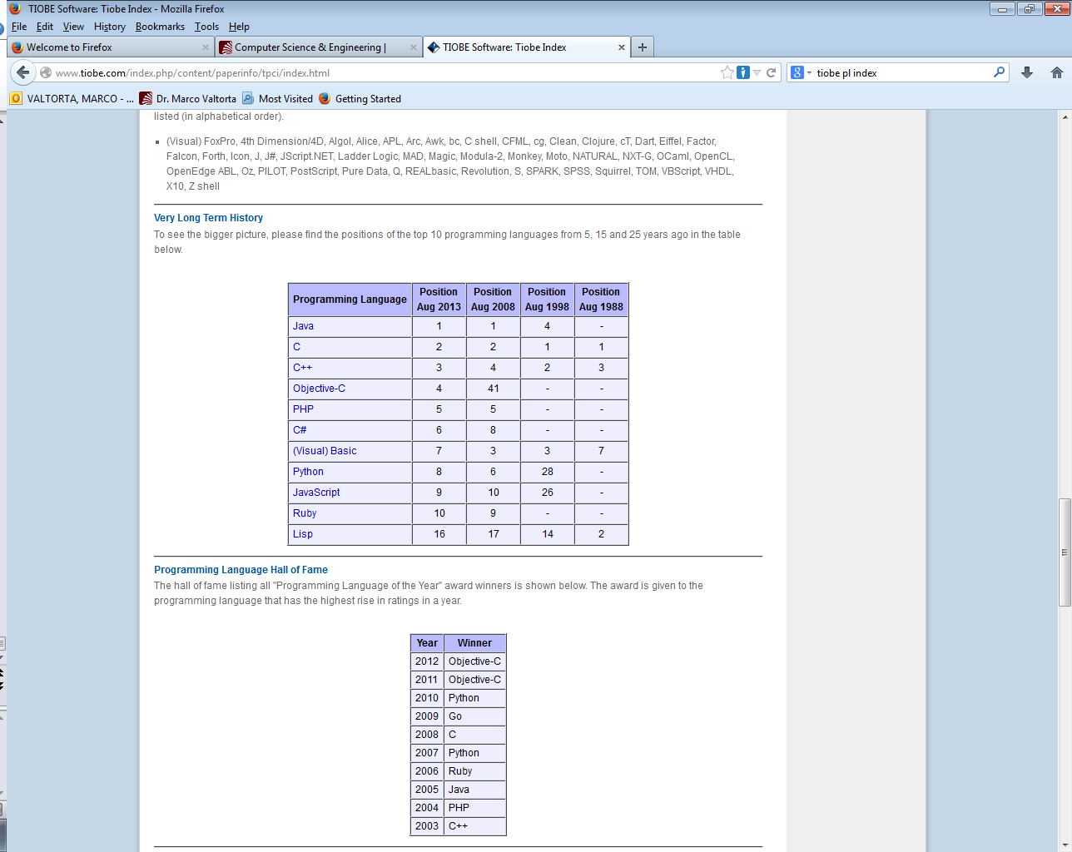
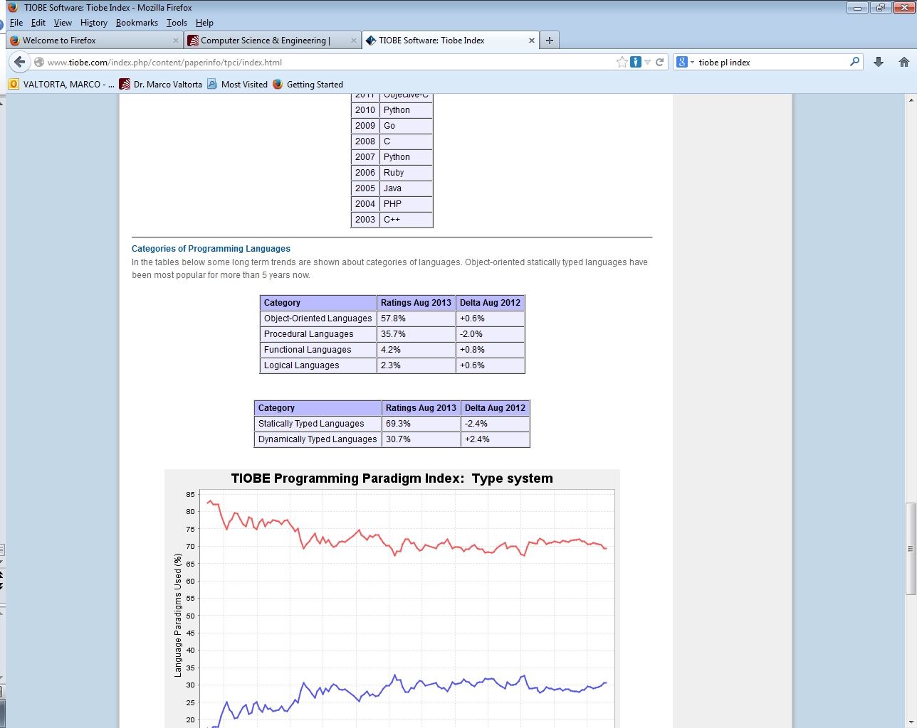
Tiobe Index Long Term Trends, August 2013
Notes:
http://www.tiobe.com/index.php/content/paperinfo/tpci/index.html, accessed 2013-08-20. The end of 2004 drop for Java is due to a change in Google. See http://www.tiobe.com/index.htm?tiobe_index, accessed on 2007-08-23.
Static vs. Dynamic Typing will be explained in a later lecture. Static typing – type checking at compile time vs. dynamic typing – checking at runtime

Slide 78
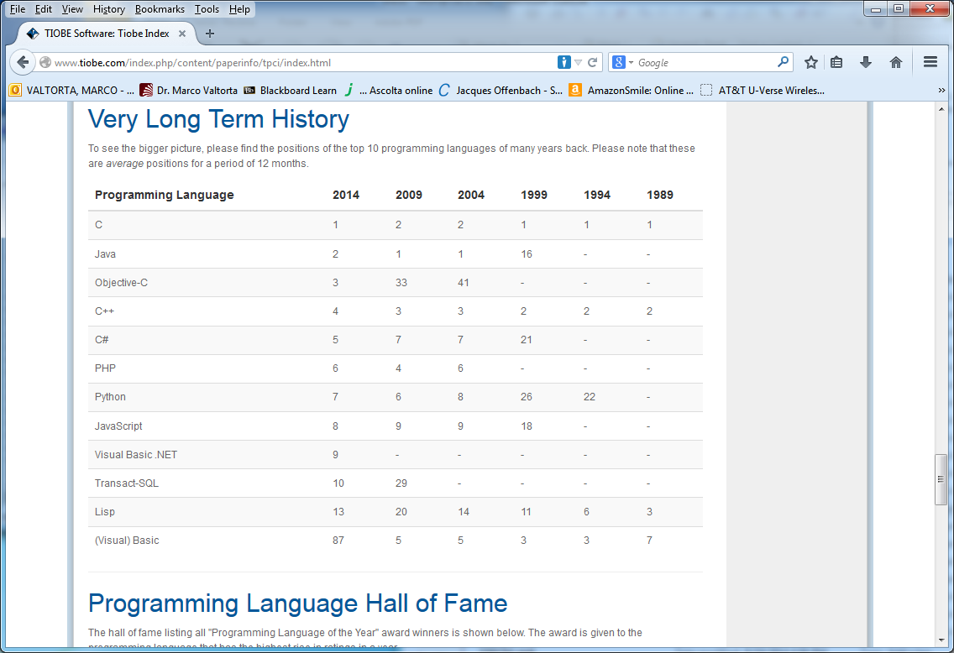
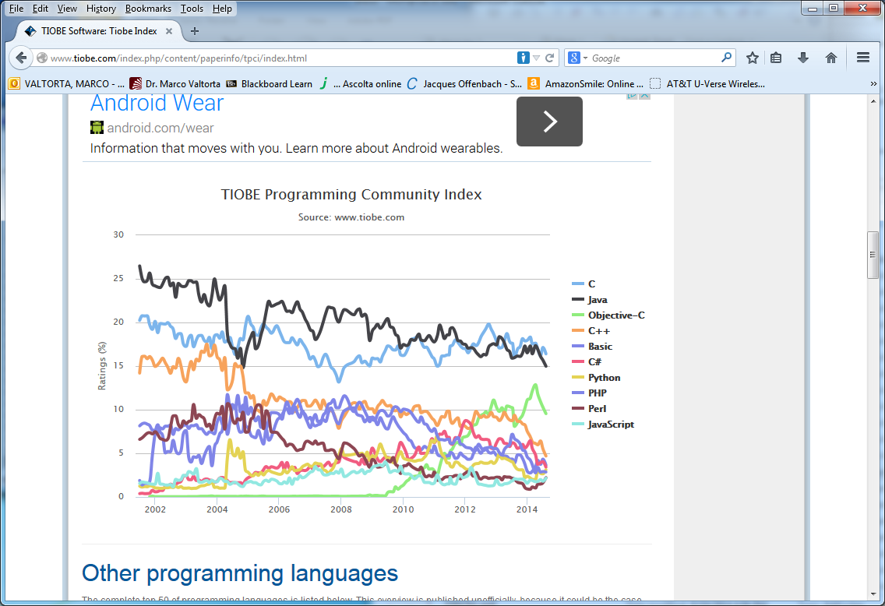
Tiobe Index Long Term Trends, August 2014
Notes:
http://www.tiobe.com/index.php/content/paperinfo/tpci/index.html, accessed 2014-08-19. The end of 2004 drop for Java is due to a change in Google. See http://www.tiobe.com/index.htm?tiobe_index, accessed on 2007-08-23. Apparently, Tiobe no longer provides “category” tables.
Static vs. Dynamic Typing will be explained in a later lecture. Static typing – type checking at compile time vs. dynamic typing – checking at runtime

Slide 79
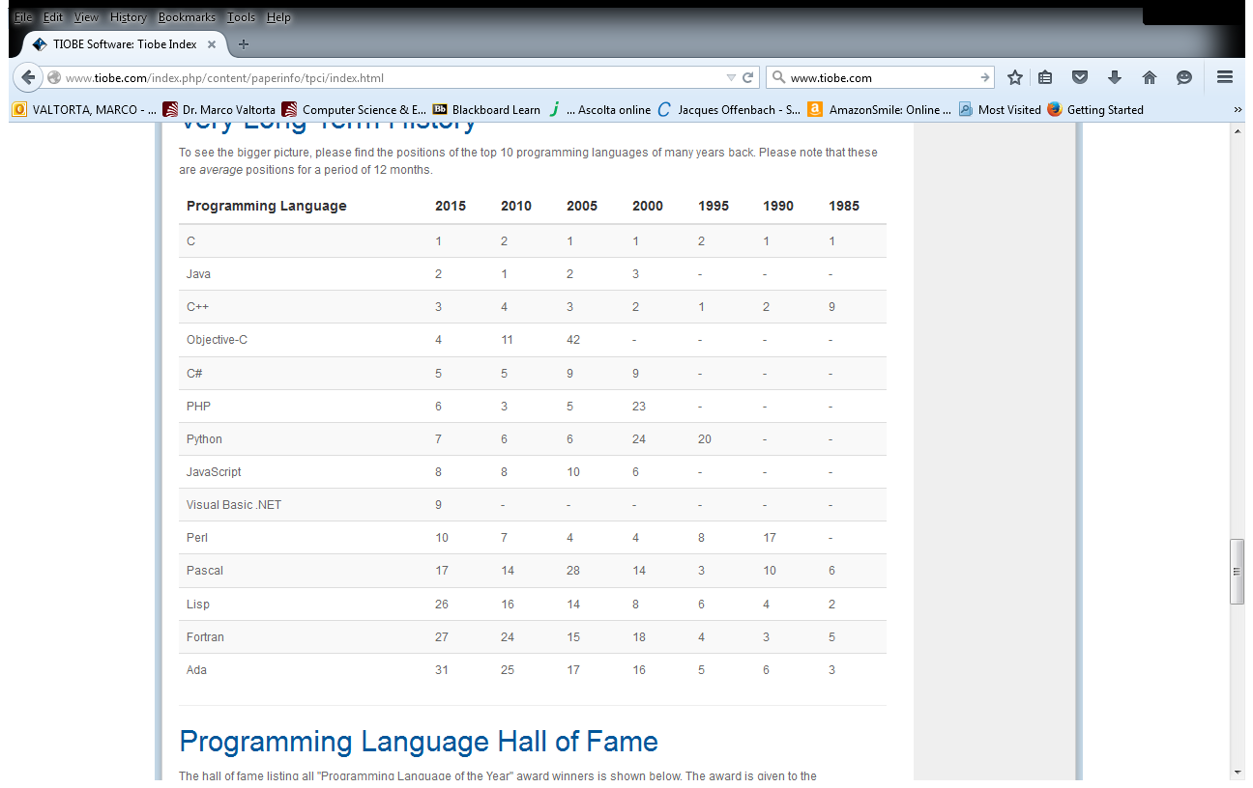
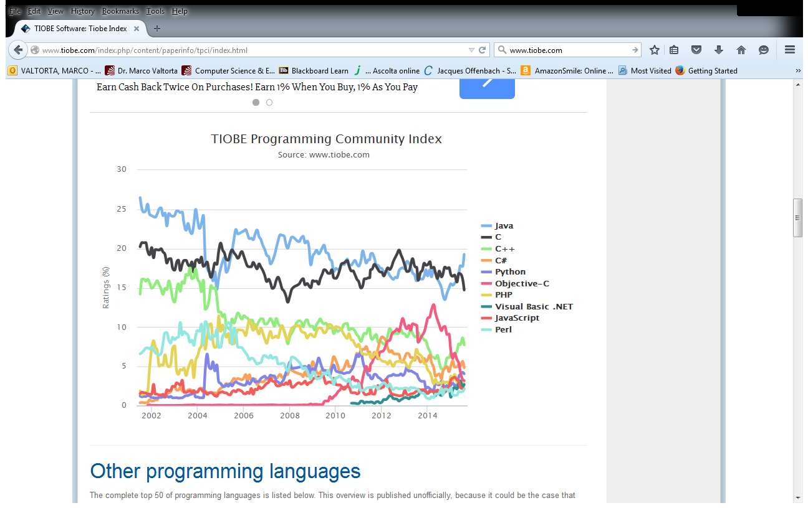
Tiobe Index Long Term Trends, August 2015
Notes:
http://www.tiobe.com/index.php/content/paperinfo/tpci/index.html, accessed 2015-08-18. The end of 2004 drop for Java is due to a change in Google. See http://www.tiobe.com/index.htm?tiobe_index, accessed on 2007-08-23. Apparently, Tiobe no longer provides “category” tables.
Static vs. Dynamic Typing will be explained in a later lecture. Static typing – type checking at compile time vs. dynamic typing – checking at runtime

Slide 80
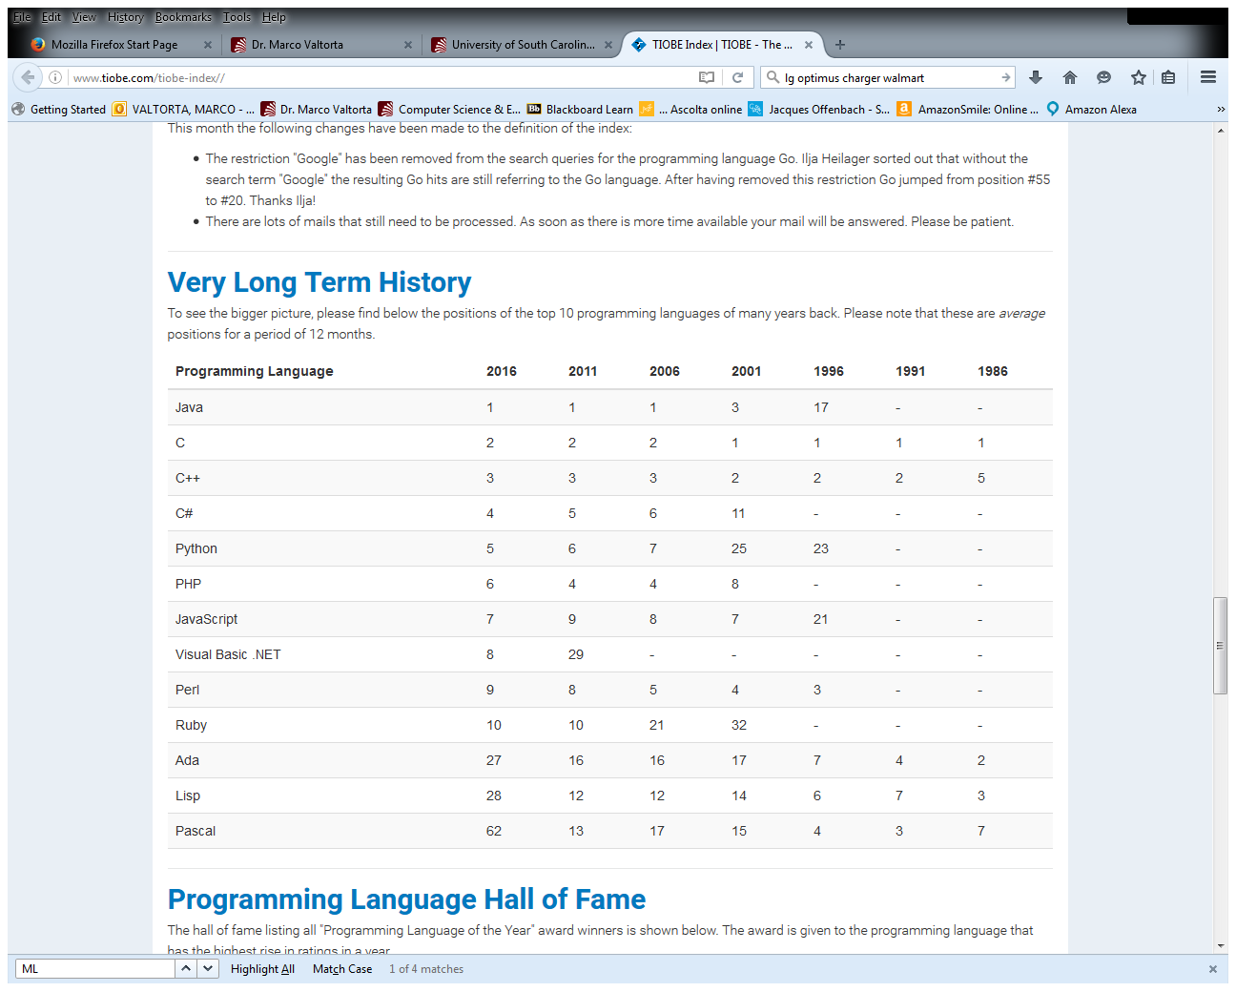
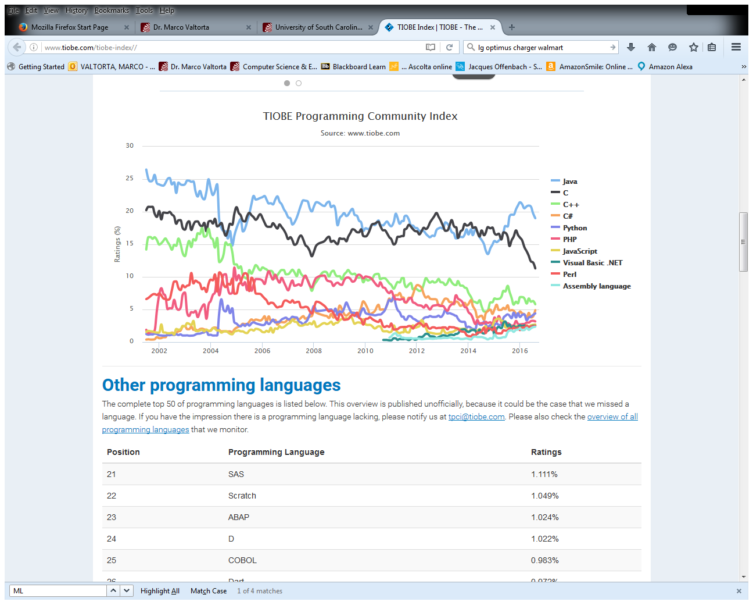
Tiobe Index Long Term Trends, August 2016
Notes:
http://www.tiobe.com/index.php/content/paperinfo/tpci/index.html, accessed 2016-08-17. The end of 2004 drop for Java is due to a change in Google. See http://www.tiobe.com/index.htm?tiobe_index, accessed on 2007-08-23. Apparently, Tiobe no longer provides “category” tables.
Static vs. Dynamic Typing will be explained in a later lecture. Static typing – type checking at compile time vs. dynamic typing – checking at runtime

Slide 81
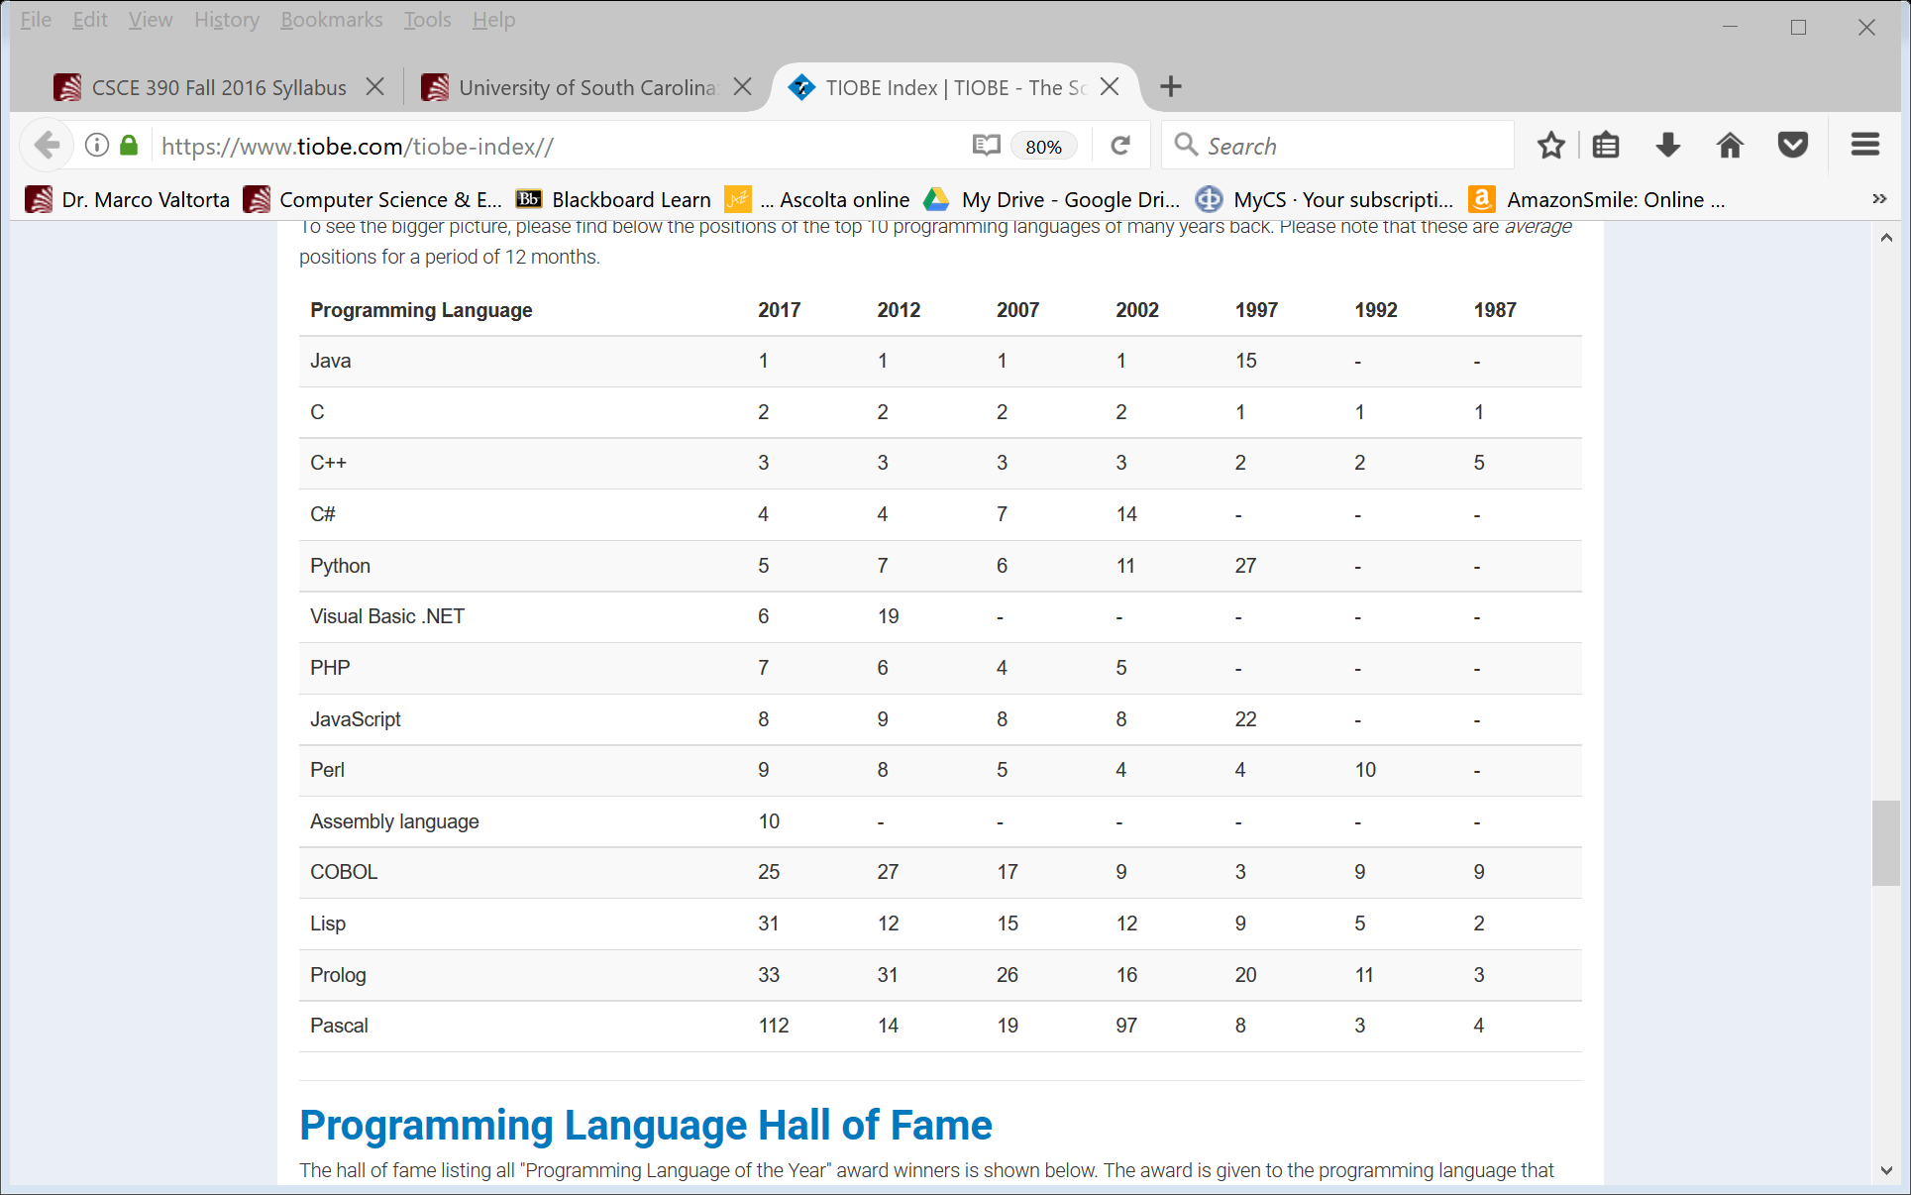
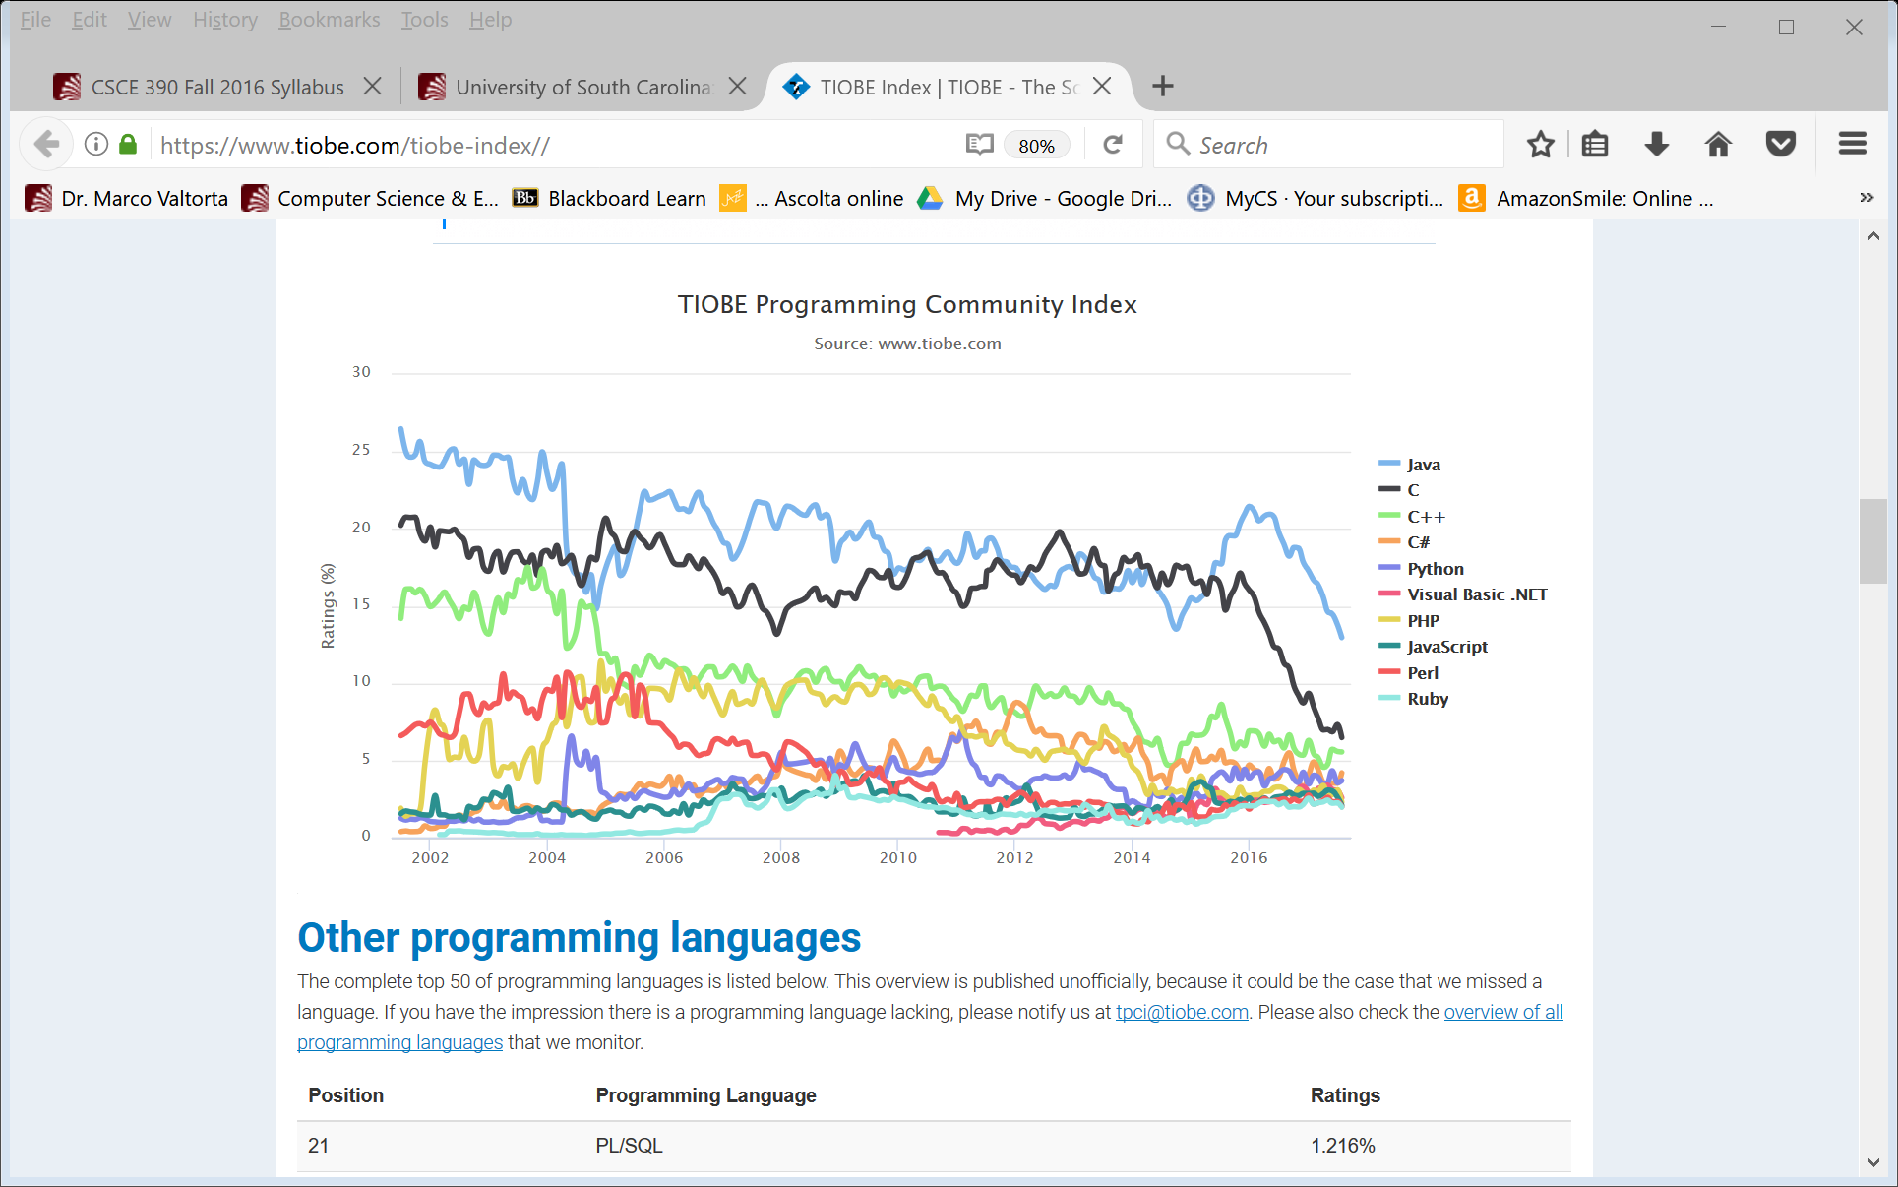
Tiobe Index Long Term Trends, August 2017
Notes:
http://www.tiobe.com/index.php/content/paperinfo/tpci/index.html, accessed 2017-08-23. The end of 2004 drop for Java is due to a change in Google. See http://www.tiobe.com/index.htm?tiobe_index, accessed on 2007-08-23. Apparently, Tiobe no longer provides “category” tables.
Static vs. Dynamic Typing will be explained in a later lecture. Static typing – type checking at compile time vs. dynamic typing – checking at runtime

Slide 82
Current links
https://www.tiobe.com/tiobe-index/
http://pypl.github.io/PYPL.html

